Slide 1
Computer Networks (BCS502)
MODULE 4
Transport Layer

Slide 2
Syllabus:
Introduction to Transport Layer: Introduction, Transport-Layer Protocols: Introduction, User Datagram Protocol, Transmission Control Protocol: services, features, segments, TCP connections, flow control, Error control, Congestion control.
Textbook 1: Ch. 23.1- 23.2, 24.1-24.3.4, 24.3.6-24.3.9
Textbook:
Behrouz A. Forouzan, Data Communications and Networking, 5th Edition, Tata McGraw-Hill,2013.

Slide 3
CHAPTER 23: Introduction to Transport Layer
23.1 INTRODUCTION
The transport layer is located between the application layer and the network layer.
It provides a process-to-process communication between two application layers, one at the local host and the other at the remote host.
Communication is provided using a logical connection, which means that the two application layers, which can be located in different parts of the globe, assume that there is an imaginary direct connection through which they can send and receive messages.
Figure 23.1 shows that only the two end systems (Alice’s and Bob’s computers) use the services of the transport layer; all intermediate routers use only the first three layers.

Slide 4
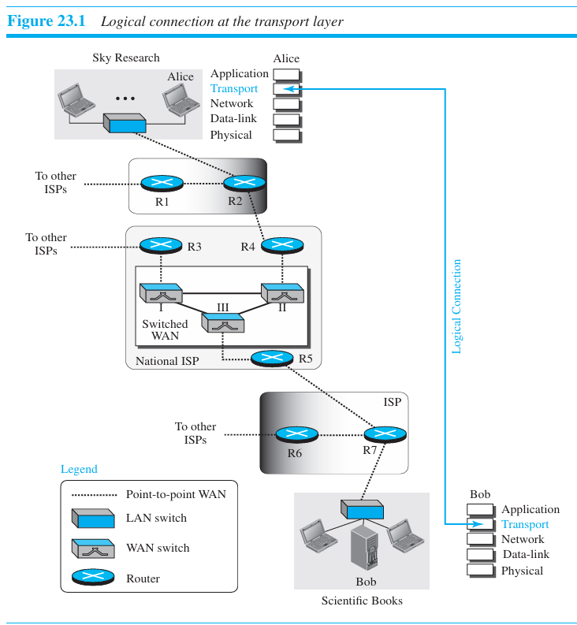

Slide 5
23.1.1 Transport-Layer Services
The transport layer is responsible for providing services to the application layer; it receives services from the network layer.
1) Process-to-Process Communication
The first duty of a transport-layer protocol is to provide process-to-process communication.
A process is an application-layer entity (running program) that uses the services of the transport layer.
The network layer is responsible for communication at the computer level (host-to-host communication). A network-layer protocol can deliver the message only to the destination computer.
However, this is an incomplete delivery. The message still needs to be handed to the correct process.
A transport-layer protocol is responsible for delivery of the message to the appropriate process. Figure 23.2 shows the domains of a network layer and a transport layer.

Slide 6
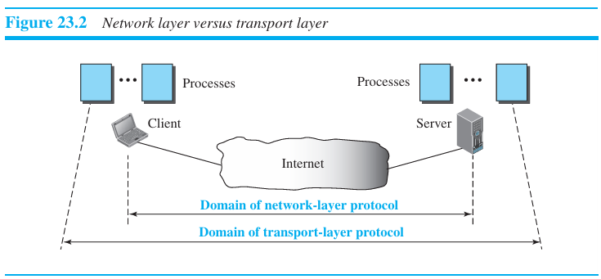

Slide 7
2) Addressing: Port Numbers
A process on the local host, called a client, needs services from a process usually on the remote host, called a server.
The local host and the remote host are defined using IP addresses To define the processes, we need second identifiers, called port numbers. In the TCP/IP protocol suite, the port numbers are integers between 0 and 65,535 (16 bits).
The client program defines itself with a port number, called the ephemeral port number. An ephemeral port number is recommended to be greater than 1023 for some client/server programs to work properly.

Slide 8
The server process must also define itself with a port number. This port number, however, cannot be chosen randomly.
TCP/IP has decided to use universal port numbers for servers; these are called well-known port numbers. Every client process knows the well-known port number of the corresponding server process.
For example, while the daytime client process, can use an ephemeral (temporary) port number, 52,000, to identify itself, the daytime server process must use the well-known (permanent) port number 13. Figure 23.3 shows this concept.
The destination IP address defines the host among the different hosts in the world. After the host has been selected, the port number defines one of the processes on this particular host (see Figure 23.4).

Slide 9
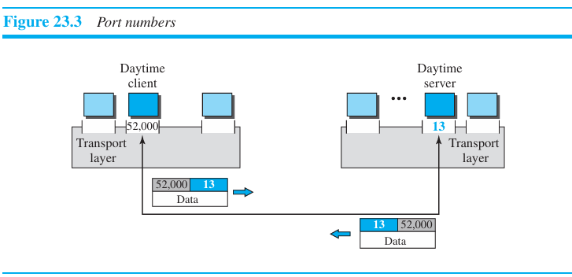

Slide 10
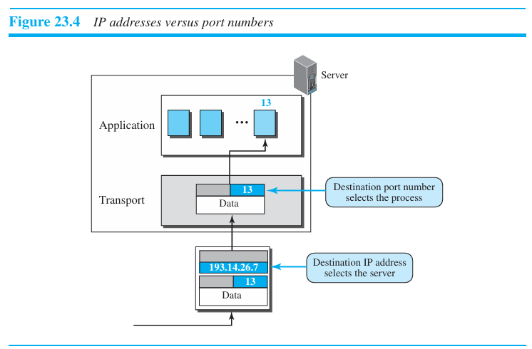

Slide 11
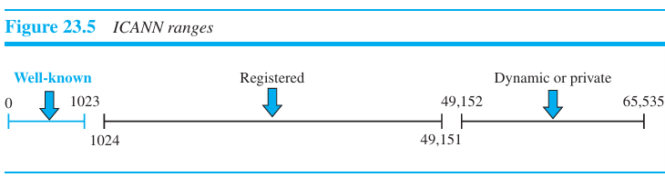
3) ICANN Ranges
ICANN has divided the port numbers into three ranges: well-known, registered, and dynamic (or private), as shown in Figure 23.5

Slide 12
Well-known ports. The ports ranging from 0 to 1023 are assigned and controlled by ICANN. These are the well-known ports.
Registered ports. The ports ranging from 1024 to 49,151 are not assigned or controlled by ICANN. They can only be registered with ICANN to prevent duplication.
Dynamic ports. The ports ranging from 49,152 to 65,535 are neither controlled nor registered. They can be used as temporary or private port numbers.

Slide 13
Example 23.1
In UNIX, the well-known ports are stored in a file called /etc/services.
Each line in this file gives the name of the server and the well-known port number.
TFTP can use port 69 on either UDP or TCP.
SNMP uses two port numbers (161 and 162), each for a different purpose.

Slide 14
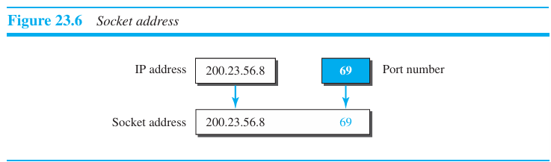
Socket Addresses
A transport-layer protocol in the TCP suite needs both the IP address and the port number, at each end, to make a connection.
The combination of an IP address and a port number is called a socket address.
The client socket address defines the client process uniquely just as the server socket address defines the server process uniquely (see Figure 23.6).

Slide 15
To use the services of the transport layer in the Internet, we need a pair of socket addresses: the client socket address and the server socket address.
These four pieces of information are part of the network-layer packet header and the transport-layer packet header.
The first header contains the IP addresses; the second header contains the port numbers.

Slide 16
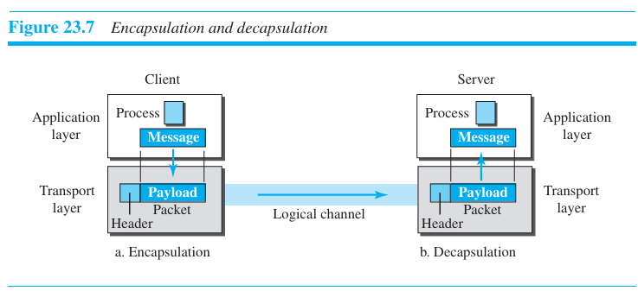
4) Encapsulation and Decapsulation
To send a message from one process to another, the transport-layer protocol encapsulates and decapsulates messages (Figure 23.7).
Encapsulation happens at the sender site. When a process has a message to send, it passes the message to the transport layer along with a pair of socket addresses.
The transport layer receives the data and adds the transport-layer header.
Decapsulation happens at the receiver site. When the message arrives at the destination transport layer, the header is dropped and the transport layer delivers the message to the process running at the application layer.
The sender socket address is passed to the process in case it needs to respond to the message received.

Slide 17
5) Multiplexing and Demultiplexing
Whenever an entity accepts items from more than one source, this is referred to as multiplexing (many to one); whenever an entity delivers items to more than one source, this is referred to as demultiplexing (one to many).
The transport layer at the source performs multiplexing; the transport layer at the destination performs demultiplexing (Figure 23.8).
Figure 23.8 shows communication between a client and two servers. Three client processes are running at the client site, P1, P2, and P3.
The processes P1 and P3 need to send requests to the corresponding server process running in a server.
The client process P2 needs to send a request to the corresponding server process running at another server.
The transport layer at the client site accepts three messages from the three processes and creates three packets. It acts as a multiplexer.
The packets 1 and 3 use the same logical channel to reach the transport layer of the first server.
When they arrive at the server, the transport layer does the job of a demultiplexer and distributes the messages to two different processes.
The transport layer at the second server receives packet 2 and delivers it to the corresponding process.

Slide 18
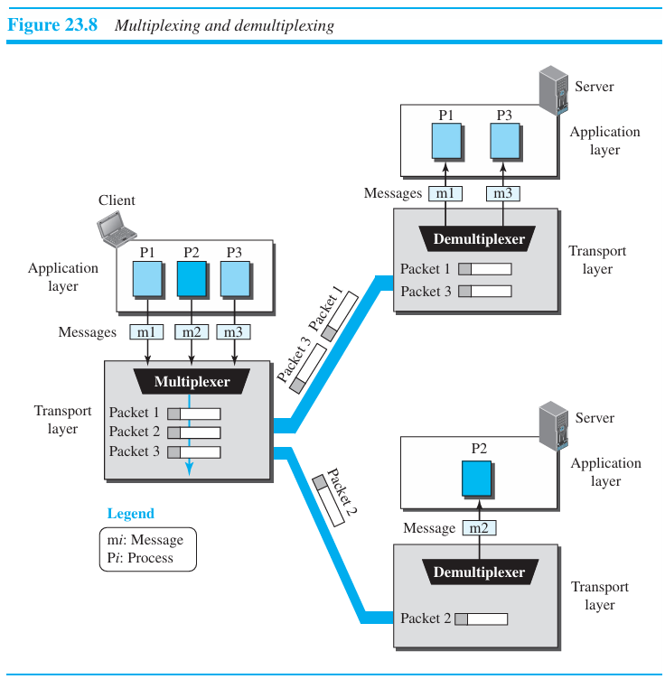

Slide 19
6) Flow Control
Whenever an entity produces items and another entity consumes them, there should be a balance between production and consumption rates.
If the items are produced faster than they can be consumed, the consumer can be overwhelmed and may need to discard some items.
If the items are produced more slowly than they can be consumed, the consumer must wait, and the system becomes less efficient.
Flow control is related to the first issue.

Slide 20
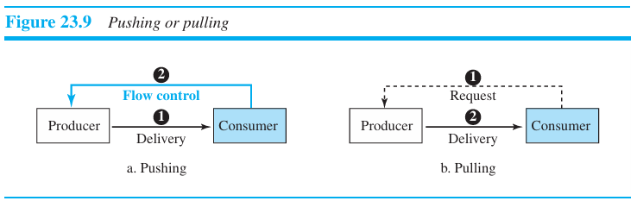
Pushing or Pulling
Delivery of items from a producer to a consumer can occur in one of two ways: pushing or pulling.
If the sender delivers items whenever they are produced⎯without a prior request from the consumer⎯the delivery is referred to as pushing.
If the producer delivers the items after the consumer has requested them, the delivery is referred to as pulling. Figure 23.9 shows these two types of delivery.

Slide 21
When the producer pushes the items, the consumer needs to warn the producer to stop the delivery and to inform the producer when it is again ready to receive the items.
When the consumer pulls the items, it requests them when it is ready. In this case, there is no need for flow control

Slide 22
Flow Control at Transport Layer
In communication at the transport layer, we are dealing with four entities: sender process, sender transport layer, receiver transport layer, and receiver process.
The sending process at the application layer is only a producer. It produces message chunks and pushes them to the transport layer.
The sending transport layer has a double role: it is both a consumer and a producer. It consumes the messages pushed by the producer.
It encapsulates the messages in packets and pushes them to the receiving transport layer.
The receiving transport layer also has a double role: it is the consumer for the packets received from the sender and the producer that decapsulates the messages and delivers them to the application layer.
The last delivery, however, is normally a pulling delivery; the transport layer waits until the application-layer process asks for messages.
Figure 23.10 shows that we need at least two cases of flow control: from the sending transport layer to the sending application layer and from the receiving transport layer to the sending transport layer.

Slide 23
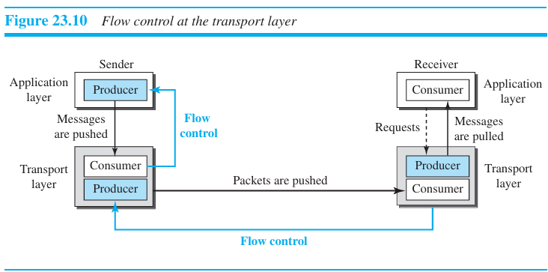

Slide 24
Buffers
Although flow control can be implemented in several ways, one of the solutions is normally to use two buffers: one at the sending transport layer and the other at the receiving transport layer.
A buffer is a set of memory locations that can hold packets at the sender and receiver.
The flow control communication can occur by sending signals from the consumer to the producer.
When the buffer of the sending transport layer is full, it informs the application layer to stop passing chunks of messages.
When the buffer of the receiving transport layer is full, it informs the sending transport layer to stop sending packets.

Slide 25
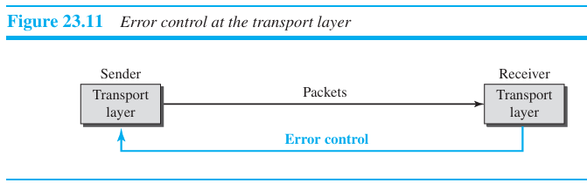
7) Error Control
In the Internet, since the underlying network layer (IP) is unreliable, we need to make the transport layer reliable if the application requires reliability.
Reliability can be achieved to add error control services to the transport layer.
Error control at the trans port layer is responsible for
Detecting and discarding corrupted packets.
Keeping track of lost and discarded packets and resending them.
Recognizing duplicate packets and discarding them.
Buffering out-of-order packets until the missing packets arrive.

Slide 26
Sequence Numbers
Error control requires that the sending transport layer knows which packet is to be resent and the receiving transport layer knows which packet is a duplicate, or which packet has arrived out of order.
This can be done if the packets are numbered. We can add a field to the transport-layer packet to hold the sequence number of the packet.
The out-of-order packets can be recognized by observing gaps in the sequence numbers. Packets are numbered sequentially.
If the header of the packet allows m bits for the sequence number, the sequence numbers range from 0 to 2^{m} − 1. In other words, the sequence numbers are modulo 2^{m}.

Slide 27
Acknowledgment
The receiver side can send an acknowledgment (ACK) for each of a collection of packets that have arrived safe and sound.
The receiver can simply discard the corrupted packets.
The sender can detect lost packets if it uses a timer. When a packet is sent, the sender starts a timer.
If an ACK does not arrive before the timer expires, the sender resends the packet.
Duplicate packets can be silently discarded by the receiver. Out-of-order packets can be either discarded (to be treated as lost packets by the sender), or stored until the missing one arrives.

Slide 28
8) Combination of Flow and Error Control
Flow control requires the use of two buffers, one at the sender site and the other at the receiver site. A error control requires the use of sequence and acknowledgment numbers by both sides.
These two requirements can be combined if we use two numbered buffers, one at the sender, one at the receiver.
At the sender, when a packet is prepared to be sent, we use the number of the next free location, x, in the buffer as the sequence number of the packet.
When the packet is sent, a copy is stored at memory location x, awaiting the acknowledgment from the other end.

Slide 29
When an acknowledgment related to a sent packet arrives, the memory location becomes free.
At the receiver, when a packet with sequence number y arrives, it is stored at the memory location y until the application layer is ready to receive it. An acknowledgment can be sent to announce the arrival of packet y.

Slide 30
Sliding Window
Since the sequence numbers use modulo 2^{m}, a circle can represent the sequence numbers from 0 to 2^{m} − 1.
The buffer is represented as a set of slices, called the sliding window.
At the sender site, when a packet is sent, the corresponding slice is marked.
When all the slices are marked, it means that the buffer is full and no further messages can be accepted from the application layer.
When an acknowledgment arrives, the corresponding slice is unmarked.

Slide 31
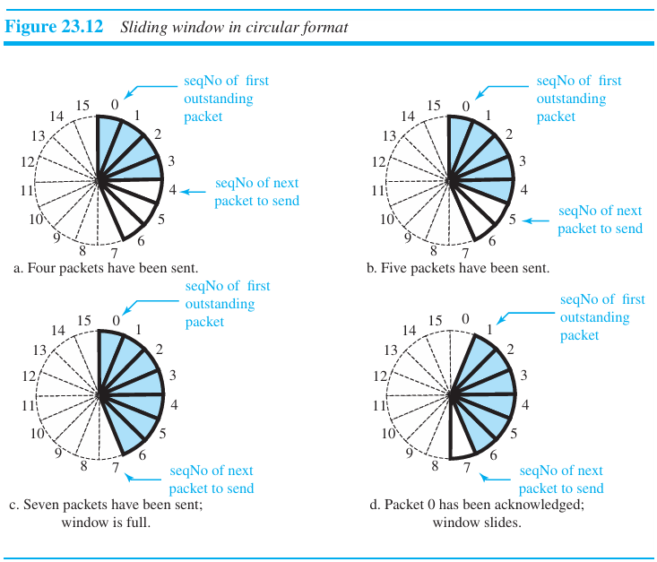

Slide 32
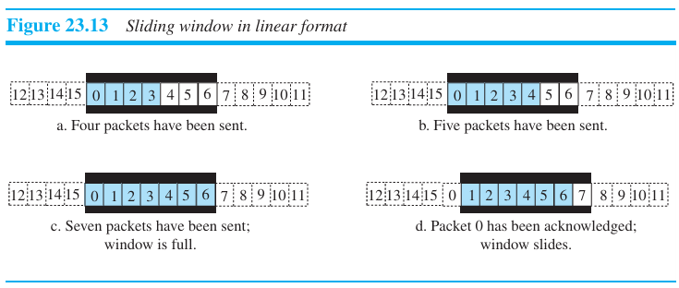

Slide 33
9) Congestion Control
Congestion in a network may occur if the load on the network—the number of packets sent to the network—is greater than the capacity of the network—the number of packets a network can handle.
Congestion control refers to the mechanisms and techniques that control the congestion and keep the load below the capacity.
Congestion in a network or internetwork occurs because routers and switches have queues—buffers that hold the packets before and after processing.
If a router cannot process the packets at the same rate at which they arrive, the queues become overloaded and congestion occurs.
Congestion at the transport layer is actually the result of congestion at the network layer, which manifests itself at the transport layer.

Slide 34
23.1.2 Connectionless and Connection-Oriented Protocols
A transport-layer protocol, like a network-layer protocol, can provide two types of services: connectionless and connection-oriented.
Connectionless Service
In a connectionless service, the source process needs to divide its message into chunks of data of the size acceptable by the transport layer and deliver them to the transport layer one by one.
The transport layer treats each chunk as a single unit without any relation between the chunks.

Slide 35
To show the independency of packets, assume that a client process has three chunks of messages to send to a server process.
The chunks are handed over to the connectionless transport protocol inorder.
However, since there is no dependency between the packets at the transport layer, the packets may arrive out of order at the destination and will be delivered out of order to the server process
Since there is no numbering on the packets, the receiving transport layer has no idea if one of the messages has been lost.
No flow control, error control, or congestion control can be effectively implemented in a connectionless service.

Slide 36
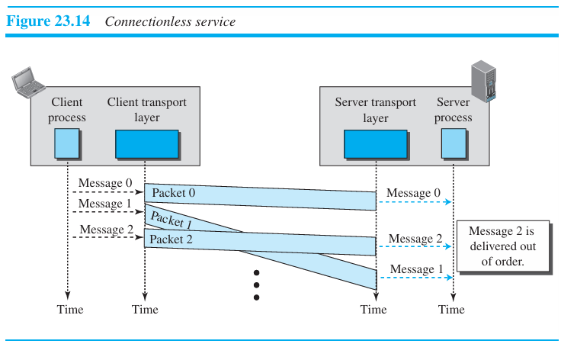

Slide 37
Connection-Oriented Service
In a connection-oriented service, the client and the server first need to establish a logical connection between themselves.
After data exchange, the connection needs to be torn down.
At the transport layer, connection-oriented service involves only the two hosts; the service is end to end.
The connection-oriented protocol at the transport layer is over either a connectionless or connection-oriented protocol at the network layer.
Figure 23.15 shows the connection establishment, data-transfer, and tear-down phases in a connection-oriented service at the transport layer.
We can implement flow control, error control, and congestion control in a connection oriented protocol.

Slide 38
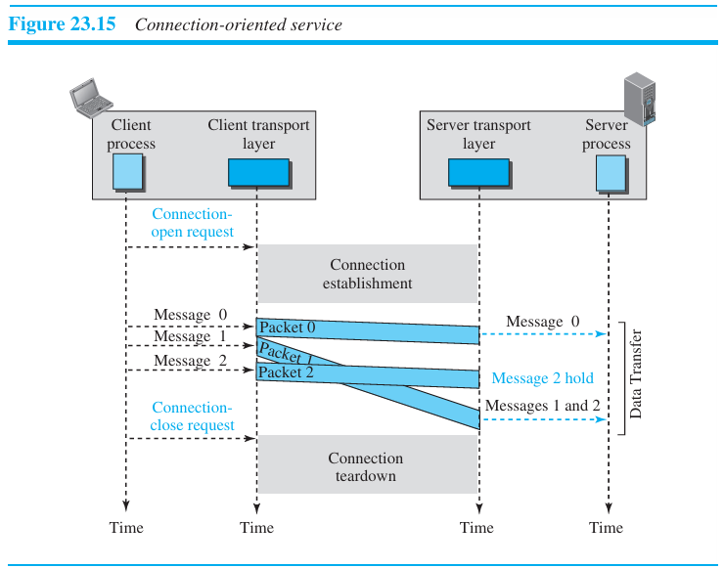

Slide 39
Finite State Machine
The behavior of a transport-layer protocol, both when it provides a connectionless and when it provides a connection-oriented protocol, is shown as a finite state machine (FSM) in Figure 23.16.
The machine is always in one of the states until an event occurs.
The connectionless transport layer is an FSM with only one state: the established state. The machine on each end (client and server) is always in the established state, ready to send and receive transport-layer packets.
An FSM in a connection-oriented transport layer, on the other hand, needs to go through three states before reaching the established state. The machine also needs to go through three states before closing the connection.
The machine is in the closed state when there is no connection. It remains in this state until a request for opening the connection arrives from the local process; the machine sends an open request packet to the remote transport layer and moves to the open-wait-I state.
When an acknowledgment is received from the other end, the local FSM moves to the open-wait-II state.

Slide 40
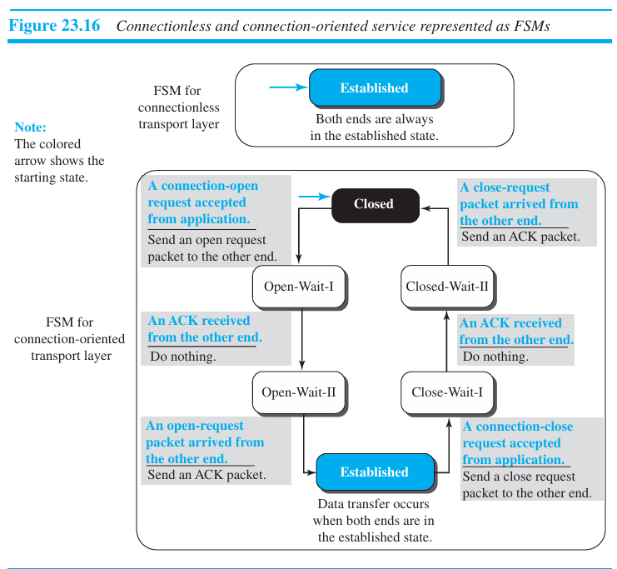

Slide 41
When the machine is in this state, a unidirectional connection has been established, but if a bidirectional connection is needed, the machine needs to wait in this state until the other end also requests a connection.
When the request is received, the machine sends an acknowledgment and moves to the established state.
Data and data acknowledgment can be exchanged between the two ends when they are both in the established state.
To tear down a connection, the application layer sends a close request message to its local transport layer. The transport layer sends a close-request packet to the other end and moves to close-wait-I state.
When an acknowledgment is received from the other end, the machine moves to the close-wait-II state and waits for the close-request packet from the other end. When this packet arrives, the machine sends an acknowledgment and moves to the closed state.

Slide 42
23.2 TRANSPORT-LAYER PROTOCOLS
23.2.1 Simple Protocol
The first protocol (Figure 23.17 ) is a simple connectionless protocol with neither flow nor error control.
We assume that the receiver can immediately handle any packet it receives. The receiver can never be overwhelmed with incoming packets.
The transport layer at the sender gets a message from its application layer, makes a packet out of it, and sends the packet.
The transport layer at the receiver receives a packet from its network layer, extracts the message from the packet, and delivers the message to its application layer.

Slide 43
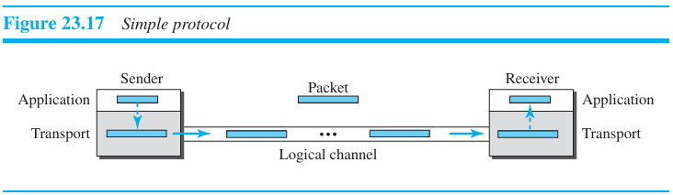

Slide 44
FSMs
The sending machine remains in the ready state until a request comes from the process in the application layer.
When this event occurs, the sending machine encapsulates the message in a packet and sends it to the receiving machine.
The receiving machine remains in the ready state until a packet arrives from the sending machine.
When this event occurs, the receiving machine decapsulates the message out of the packet and delivers it to the process at the application layer (Figure 23.18).

Slide 45
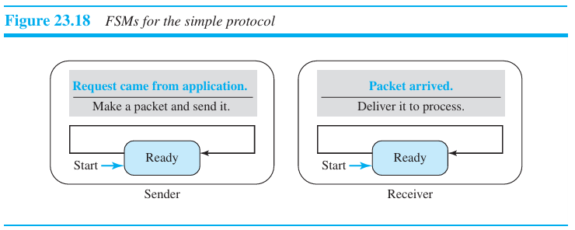

Slide 46
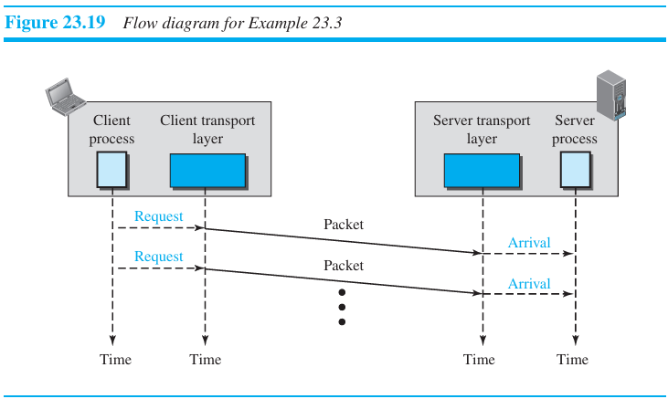
Example 23.3
Figure 23.19 shows an example of communication using this protocol. The sender sends packets one after another without even thinking about the receiver.

Slide 47
23.2.2 Stop-and-Wait Protocol
Stop-and-Wait protocol is a connection-oriented protocol, which uses both flow and error control. Both the sender and the receiver use a sliding window of size 1.
The sender sends one packet at a time and waits for an acknowledgment before sending the next one.
To detect corrupted packets, we need to add a checksum to each data packet. When a packet arrives at the receiver site, it is checked. If its checksum is incorrect, the packet is corrupted and silently discarded.
Every time the sender sends a packet, it starts a timer. If an acknowledgment arrives before the timer expires, the timer is stopped and the sender sends the next packet.
If the timer expires, the sender resends the previous packet, assuming that the packet was either lost or corrupted.
This means that the sender needs to keep a copy of the packet until its acknowledgment arrives. Figure 23.20 shows the outline for the Stop-and-Wait protocol.
Note that only one packet and one acknowledgment can be in the channels at any time.

Slide 48
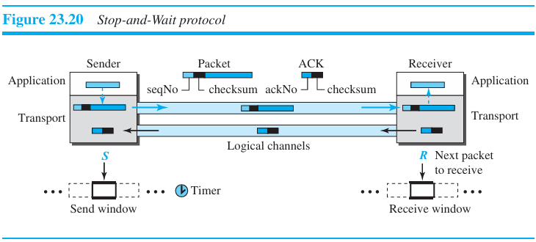

Slide 49
Sequence Numbers
To prevent duplicate packets, the protocol uses sequence numbers and acknowledgment numbers.
A field is added to the packet header to hold the sequence number of that packet.
We can see that there is a need for sequence numbers x and x + 1. But there is no need for a packet to be numbered x + 2.
The packet can be numbered x again because packets x and x + 1 are acknowledged and there is no ambiguity at either site.
Hence, sequence number is 0, 1, 0, 1, 0, and so on. This is referred to as modulo 2 arithmetic.

Slide 50
Acknowledgment Numbers
The acknowledgment numbers always announce the sequence number of the next packet expected by the receiver.
For example, if packet 0 has arrived safe and sound, the receiver sends an ACK with acknowledgment 1 (meaning packet 1 is expected next).
If packet 1 has arrived safe and sound, the receiver sends an ACK with acknowledgment 0 (meaning packet 0 is expected).

Slide 51
FSMs
Figure 23.21 shows the FSMs for the Stop-and-Wait protocol.
Since the protocol is a connection-oriented protocol, both ends should be in the established state before exchanging data packets.
The states are actually nested in the established state.

Slide 52
Sender
The sender is initially in the ready state, but it can move between the ready and blocking state. The variable S is initialized to 0.
Ready state. When the sender is in this state, it is only waiting for one event to occur. If a request comes from the application layer, the sender creates a packet with the sequence number set to S. A copy of the packet is stored, and the packet is sent. The sender then starts the only timer. The sender then moves to the blocking state.
Blocking state. When the sender is in this state, three events can occur
  If an error-free ACK, ackNo = (S + 1) modulo 2 arrives, the timer is stopped. The window slides, S = (S + 1) modulo 2. Finally, the sender moves to the ready state.
  If a corrupted ACK or an error-free ACK with the ackNo ≠ (S + 1) modulo 2 arrives, the ACK is discarded.
  If a time-out occurs, the sender resends the only outstanding packet and restarts the timer.

Slide 53
Receiver
The receiver is always in the ready state. Three events may occur:
  If an error-free packet with seqNo = R arrives, the message in the packet is delivered to the application layer. The window then slides, R = (R + 1) modulo 2. Finally an ACK with ackNo = R is sent. b.
  If an error-free packet with seqNo ≠ R arrives, the packet is discarded, but an ACK with ackNo = R is sent. c.
  If a corrupted packet arrives, the packet is discarded.

Slide 54
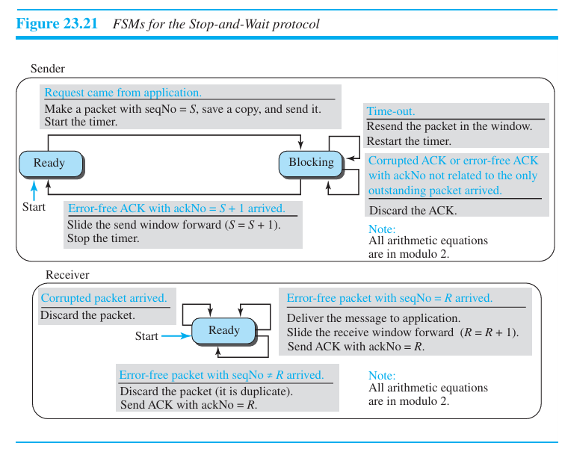

Slide 55
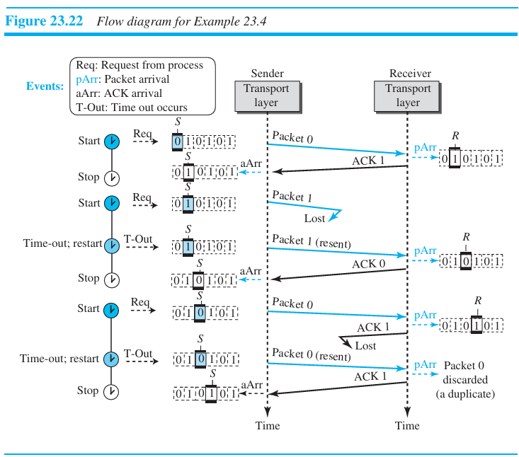

Slide 56
Figure 23.22 shows an example of the Stop-and-Wait protocol.
Packet 0 is sent and acknowledged. Packet 1 is lost and resent after the time-out.
The resent packet 1 is acknowledged and the timer stops. Packet 0 is sent and acknowledged, but the acknowledgment is lost.
The sender has no idea if the packet or the acknowledgment is lost, so after the time-out, it resends packet 0, which is acknowledged.

Slide 57
Efficiency
The Stop-and-Wait protocol is very inefficient if the channel has a large bandwidth and the round-trip delay is long.
The product of these two is called the bandwidth delay product.
The bandwidth-delay product is a measure of the number of bits a sender can transmit through the system while waiting for an acknowledgment from the receiver.

Slide 58
Assume that, in a Stop-and-Wait system, the bandwidth of the line is 1 Mbps, and 1 bit takes 20 milliseconds to make a round trip. What is the bandwidth-delay product? If the system data packets are 1,000 bits in length, what is the utilization percentage of the link?
Solution:
The bandwidth-delay product is (1 × 10⁶) × (20 × 10⁻³) = 20,000 bits. The system can send 20,000 bits during the time it takes for the data to go from the sender to the receiver and the acknowledgment to come back. However, the system sends only 1,000 bits. We can say that the link utilization is only 1,000/20,000, or 5 percent. For this reason, in a link with a high bandwidth or long delay, the use of Stop-and-Wait wastes the capacity of the link.

Slide 59
What is the utilization percentage of the link if we have a protocol that can send up to 15 packets before stopping and worrying about the acknowledgments?
Solution
The bandwidth-delay product is still 20,000 bits. The system can send up to 15 packets or 15,000 bits during a round trip. This means the utilization is 15,000/20,000, or 75 percent. Of course, if there are damaged packets, the utilization percentage is much less because packets have to be resent.

Slide 60
Pipelining
In networking and in other areas, a task is often begun before the previous task has ended. This is known as pipelining.
There is no pipelining in the Stop-and-Wait protocol because a sender must wait for a packet to reach the destination and be acknowledged before the next packet can be sent.

Slide 61
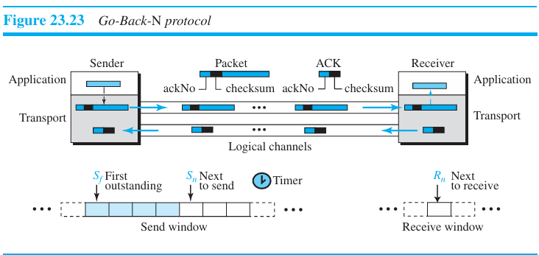
23.2.3 Go-Back-N Protocol (GBN)
The key to Go-back-N is that we can send several packets before receiving acknowledgments, but the receiver can only buffer one packet.
We keep a copy of the sent packets until the acknowledgments arrive.

Slide 62
Sequence Numbers
The sequence numbers are modulo 2^{m}, where m is the size of the sequence number field in bits.
Acknowledgment Numbers
An acknowledgment number in this protocol is cumulative and defines the sequence number of the next packet expected.
For example, if the acknowledgment number (ackNo) is 7, it means all packets with sequence number up to 6 have arrived, safe and sound, and the receiver is expecting the packet with sequence number 7.

Slide 63
Send Window
The maximum size of the window is 2^{m} – 1. The send window at any time divides the possible sequence numbers into four regions.
The first region, left of the window, defines the sequence numbers belonging to packets that are already acknowledged.
The second region, defines the range of sequence numbers belonging to the packets that have been sent, but have an unknown status known as outstanding packets.
The third range, defines the range of sequence numbers for packets that can be sent; however, the corresponding data have not yet been received from the application layer. Finally, the fourth region, right of the window, defines sequence numbers that cannot be used until the window slides.
Figure 23.24 shows a sliding window of size 7 (m = 3) for the Go-Back-N protocol.

Slide 64
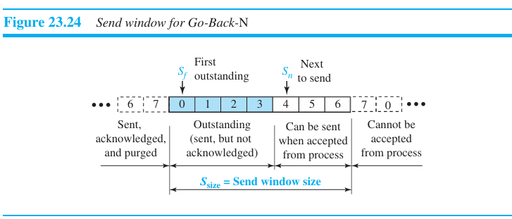

Slide 65
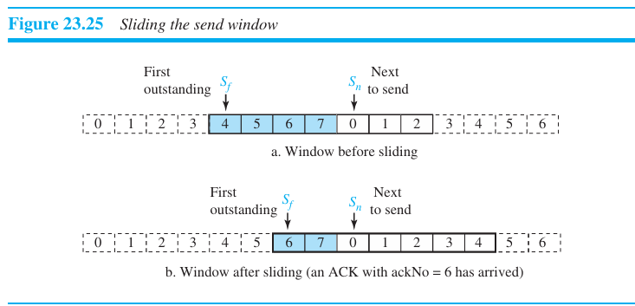
S_{f} (send window, the first outstanding packet), S_{n} (send window, the next packet to be sent), and S_{size} (send window, size).
The variable S_{f} defines the sequence number of the first (oldest) outstanding packet.
The variable S_{n} holds the sequence number that will be assigned to the next packet to be sent. Finally, the variable S_{size} defines the size of the window.

Slide 66
Receive Window
In Go-Back-N, the size of the receive window is always 1. The receiver is always looking for the arrival of a specific packet.
Any packet arriving out of order is discarded and needs to be resent. Figure 23.26 shows the receive window.
We need only one variable, R_{n} (receive window, next packet expected), to define this abstraction.
Only a packet with a sequence number matching the value of R_{n} is accepted and acknowledged. The receive window also slides, but only one slot at a time.
When a correct packet is received, the window slides, R_{n} = (R_{n} + 1) modulo 2^{m}.

Slide 67
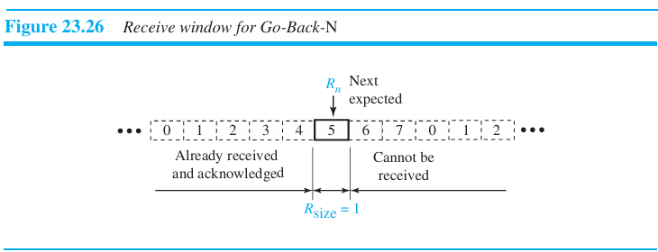

Slide 68
Timers
When the timer for the first outstanding packet always expires, we resend all outstanding packets when this timer expires.
Resending packets
When the timer expires, the sender resends all outstanding packets.
For example, suppose the sender has already sent packet 6 (S_{n} = 7), but the only timer expires. If S_{f} = 3, this means that packets 3, 4, 5, and 6 have not been acknowledged; the sender goes back and resends packets 3, 4, 5, and 6.
That is why the protocol is called Go-Back-N. On a time-out, the machine goes back N locations and resends all packets.

Slide 69
FSMs
Figure 23.27 shows the FSMs for the GBN protocol.
Sender:
The sender starts in the ready state, but thereafter it can be in one of the two states: ready or blocking. The two variables are normally initialized to 0 (S_{f} = S_{n} = 0).
Ready state. Four events may occur when the sender is in ready state.
If a request comes from the application layer, the sender creates a packet with the sequence number set to S_{n}. A copy of the packet is stored, and the packet is sent. The sender also starts the only timer if it is not running. The value of Sn is now incremented, (S_{n} = S_{n} + 1) modulo 2^{m}. If the window is full, S_{n} = (S_{f} + S_{size}) modulo 2^{m}, the sender goes to the blocking state.
If an error-free ACK arrives with ackNo related to one of the outstanding pack ets, the sender slides the window (set S_{f} = ackNo), and if all outstanding packets are acknowledged (ackNo = S_{n}), then the timer is stopped. If all outstanding packets are not acknowledged, the timer is restarted.
If a corrupted ACK or an error-free ACK with ackNo not related to the outstanding packet arrives, it is discarded.
If a time-out occurs, the sender resends all outstanding packets and restarts the timer.

Slide 70
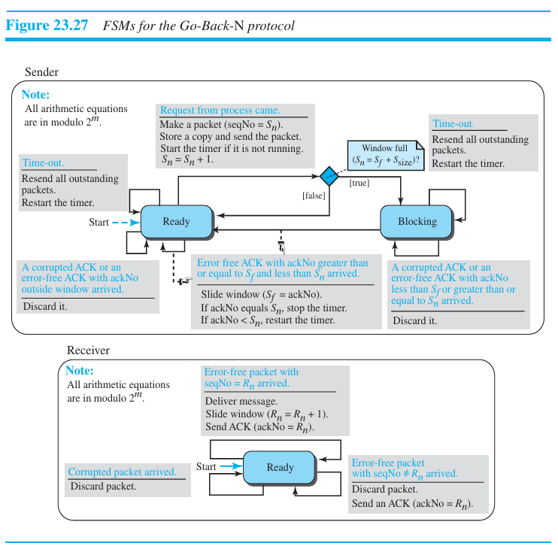

Slide 71
Blocking state. Three events may occur in this case:
If an error-free ACK arrives with ackNo related to one of the outstanding pack ets, the sender slides the window (set Sf = ackNo) and if all outstanding packets are acknowledged (ackNo = Sn), then the timer is stopped. If all outstanding packets are not acknowledged, the timer is restarted. The sender then moves to the ready state.
If a corrupted ACK or an error-free ACK with the ackNo not related to the outstanding packets arrives, the ACK is discarded.
If a time-out occurs, the sender sends all outstanding packets and restarts the timer.

Slide 72
Receiver:
The receiver is always in the ready state. The only variable, R_{n}, is initialized to 0. Three events may occur:
If an error-free packet with seqNo = R_{n} arrives, the message in the packet is delivered to the application layer. The window then slides, R_{n} = (R_{n} + 1) modulo 2^{m}. Finally an ACK is sent with ackNo = R_{n}
If an error-free packet with seqNo outside the window arrives, the packet is dis carded, but an ACK with ackNo = R_{n} is sent.
If a corrupted packet arrives, it is discarded.

Slide 73
Send Window Size
The size of the send window must be less than 2m.
For m=2, if the size of the window is 3 (less than 2^{m}) and all three acknowledgments are lost, the only timer expires and all three packets are resent. The receiver is now expecting packet 3, not packet 0, so the duplicate packet is correctly discarded.
On the other hand, if the size of the window is 4 (equal to 2^{m}) and all acknowledgments are lost, the sender will send a duplicate of packet 0. How ever, this time the window of the receiver expects to receive packet 0 (in the next cycle), so it accepts packet 0, not as a duplicate, but as the first packet in the next cycle.

Slide 74
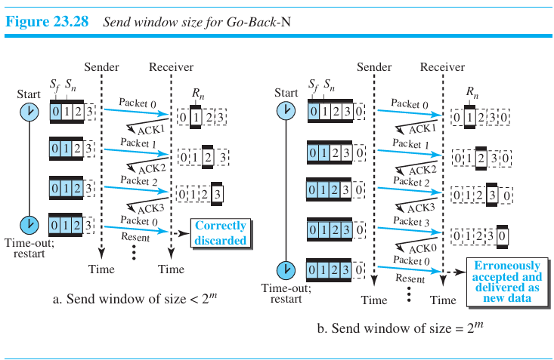

Slide 75
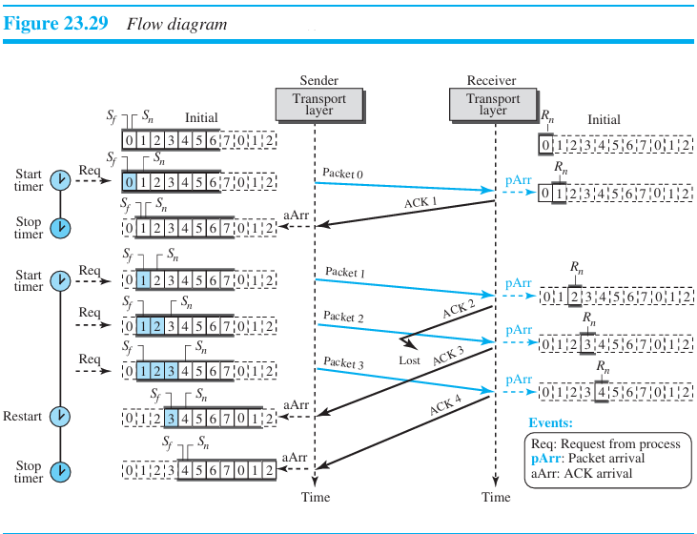
Figure 23.29 shows how cumulative acknowledgments can help if acknowledgments are delayed or lost.

Slide 76
Figure 23.30 shows what happens when a packet is lost. Packets 0, 1, 2, and 3 are sent.
How ever, packet 1 is lost.
The receiver receives packets 2 and 3, but they are discarded because packet 1 is expected. Receiver receives packets 2 and 3, it sends ACK1 to show that it expects to receive packet 1.
However, the sender discards them because the ackNo is equal to S_{f}, not greater than S_{f}.
When the time-out occurs, the sender resends packets 1, 2, and 3, which are acknowledged.

Slide 77
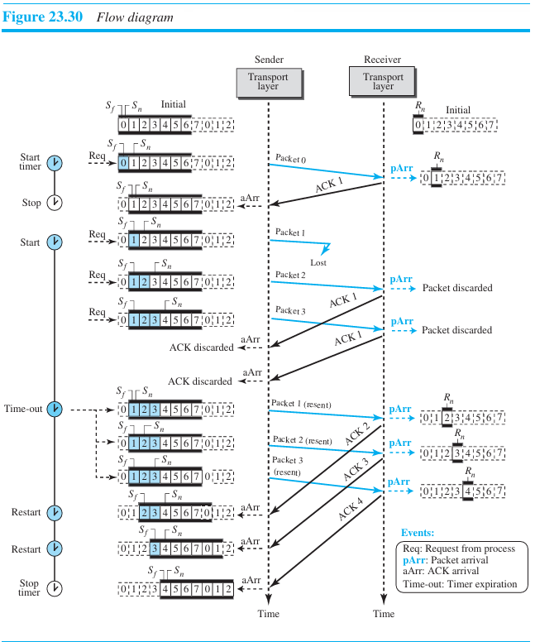

Slide 78
Go-Back-N versus Stop-and-Wait
The Stop-and-Wait protocol is actually a Go-Back-N protocol in which there are only two sequence numbers and the send window size is 1, ie), m = 1 and 2^{m} − 1 = 1.
In Go-Back-N, the arithmetic is modulo 2^{m}; in Stop-and-Wait it is modulo 2, which is the same as 2^{m} when m = 1.

Slide 79
23.2.4 Selective-Repeat Protocol
The Go-Back-N protocol is inefficient because, each time a single packet is lost or corrupted, the sender resends all outstanding packets, even though some of these packets may have been received safe and sound but out of order.
The resending of all of these outstanding packets makes the congestion worse, and eventually more packets are lost. The Selective-Repeat (SR) protocol, resends only selective packets, those that are actually lost.
The outline of this protocol is shown in Figure 23.31.

Slide 80
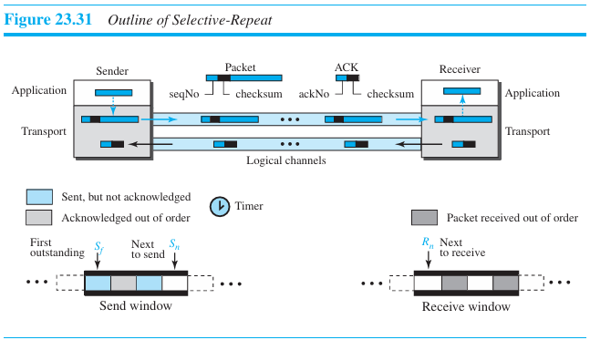

Slide 81
Windows
The Selective-Repeat protocol uses two windows: a send window and a receive window.
The maximum size of the send window is 2^{m}−1.
The receive window is the same size as the send window.
The Selective-Repeat protocol allows as many packets as the size of the receive window to arrive out of order and be kept until there is a set of consecutive packets to be delivered to the application layer.

Slide 82
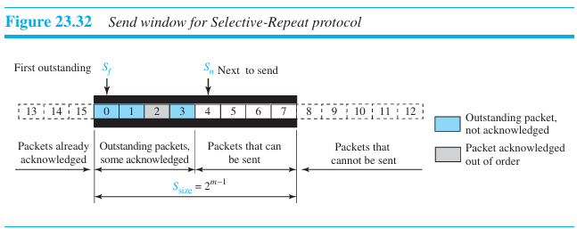

Slide 83
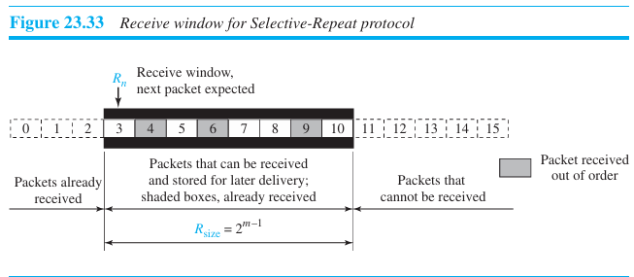

Slide 84
Timer
Selective-Repeat uses one timer for each outstanding packet.
When a timer expires, only the corresponding packet is resent.
However, most transport-layer protocols that implement SR use only a single timer.
Acknowledgments
There is yet another difference between the two protocols.
Unlike GBN where ackNo is cumulative, in SR, an ackNo defines the sequence number of a single packet that is received safe and sound; there is no feedback for any other.

Slide 85
FSMs
Figure 23.34 shows the FSMs for the Selective-Repeat protocol.
Sender:
The sender starts in the ready state, but later it can be in one of the two states: ready or blocking.
Ready state. Four events may occur in this case:
If a request comes from the application layer, the sender creates a packet with the sequence number set to S_{n}. A copy of the packet is stored, and the packet is sent. If the timer is not running, the sender starts the timer. The value of S_{n} is now incremented, Sn = (S_{n} + 1) modulo 2^{m}. If the window is full, S_{n} = (S_{f} + S_{size}) modulo 2^{m}, the sender goes to the blocking state.
If an error-free ACK arrives with ackNo related to one of the outstanding pack ets, that packet is marked as acknowledged. If the ackNo = S_{f}, the window slides to the right until the S_{f} points to the first unacknowledged packet. If there are outstanding packets, the timer is restarted; otherwise, the timer is stopped.
If a corrupted ACK or an error-free ACK with ackNo not related to an outstanding packet arrives, it is discarded.
If a time-out occurs, the sender resends all unacknowledged packets in the window and restarts the timer.

Slide 86
Blocking state. Three events may occur in this case:
If an error-free ACK arrives with ackNo related to one of the outstanding packets, that packet is marked as acknowledged. In addition, if the ackNo = S_{f}, the window is slid to the right until the S_{f} points to the first unacknowledged packet. If the window has slid, the sender moves to the ready state.
If a corrupted ACK or an error-free ACK with the ackNo not related to outstanding packets arrives, the ACK is discarded.
If a time-out occurs, the sender resends all unacknowledged packets in the window and restarts the timer.

Slide 87
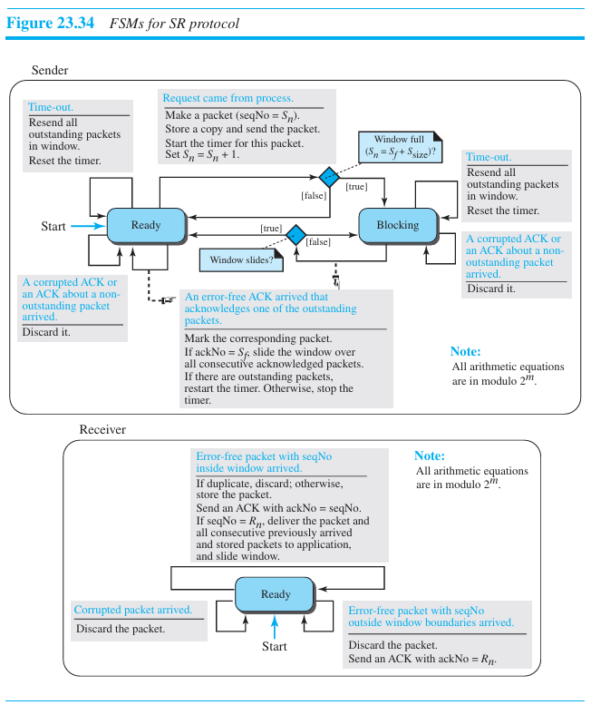

Slide 88
Receiver
The receiver is always in the ready state. Three events may occur:
If an error-free packet with seqNo in the window arrives, the packet is stored and an ACK with ackNo = seqNo is sent. In addition, if the seqNo = R_{n}, then the packet and all previously arrived consecutive packets are delivered to the application layer and the window slides so that the R_{n} points to the first empty slot.
If an error-free packet with seqNo outside the window arrives, the packet is discarded, but an ACK with ackNo = R_{n} is returned to the sender. This is needed to let the sender slide its window if some ACKs related to packets with seqNo < R_{n} were lost.
If a corrupted packet arrives, the packet is discarded.
Figure 23.35 shows the situation in which packet 1 is lost.

Slide 89
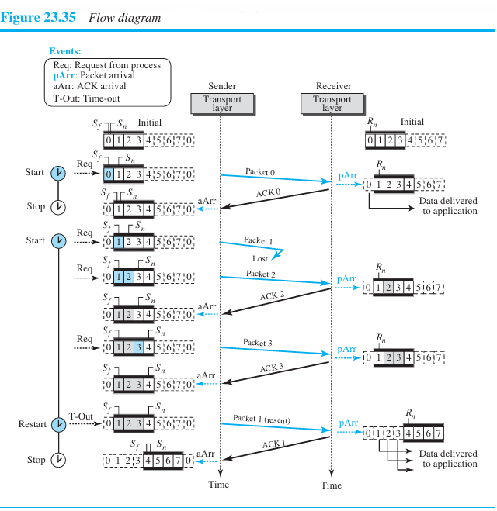
When the timer times out, packet 1 is resent and is acknowledged. The send window then slides.
At the receiver site, packet 2 arrives and is stored and marked, but it cannot be delivered because packet 1 is missing.
When finally a copy of packet 1 arrives, can packets 1, 2, and 3 be delivered to the application layer.

Slide 90
Window Sizes
The size of the sender and receiver windows can be at most one-half of 2^{m}. For an example, we choose m = 2, which means the size of the window is 2^{m}/2 = 2. Figure 23.36 compares a window size of 2 with a window size of 3.
If the size of the window is 2 and all acknowledgments are lost, the timer for packet 0 expires and packet 0 is resent.
However, the window of the receiver is now expecting packet 2, not packet 0, so this duplicate packet is correctly discarded.
When the size of the window is 3 and all acknowledgments are lost, the sender sends a duplicate of packet 0.
However, this time, the window of the receiver expects to receive packet 0 (0 is part of the window), so it accepts packet 0, not as a duplicate, but as a packet in the next cycle. This is clearly an error.

Slide 91
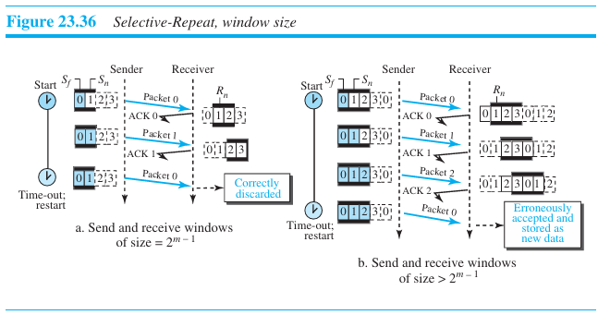

Slide 92
23.2.5 Bidirectional Protocols: Piggybacking
Data packets are normally flowing in both directions: from client to server and from server to client.
This means that acknowledgments also need to flow in both directions. A technique called piggybacking is used to improve the efficiency of the bidirectional protocols.
When a packet is carrying data from A to B, it can also carry acknowledgment feedback about arrived packets from B; when a packet is carrying data from B to A, it can also carry acknowledgment feedback about the arrived packets from A.
Figure 23.37 shows the layout for the GBN protocol implemented bidirectionally using piggybacking. The client and server each use two independent windows: send and receive.

Slide 93
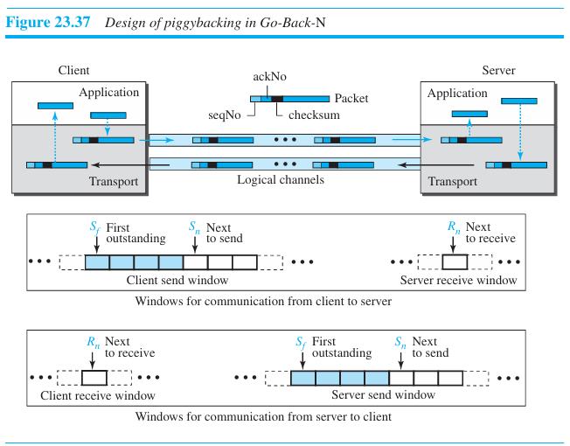

Slide 94
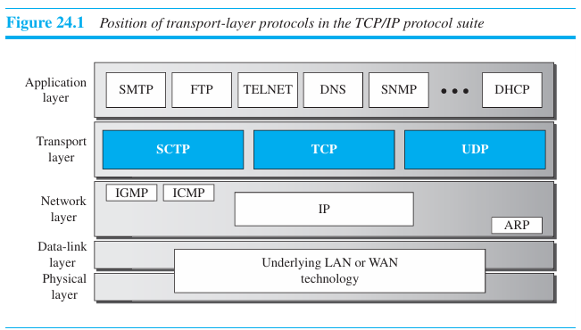
CHAPTER 23: Transport-Layer Protocols
24.1 INTRODUCTION
Figure 24.1 shows the position of these transport protocols in the TCP/IP protocol suite.

Slide 95
24.1.1 Services
UDP
UDP is an unreliable connectionless transport-layer protocol used for its simplicity and efficiency in applications where error control can be provided by the application-layer process.
TCP
TCP is a reliable connection-oriented protocol that can be used in any application where reliability is important.
SCTP
SCTP is a new transport-layer protocol that combines the features of UDP and TCP.

Slide 96
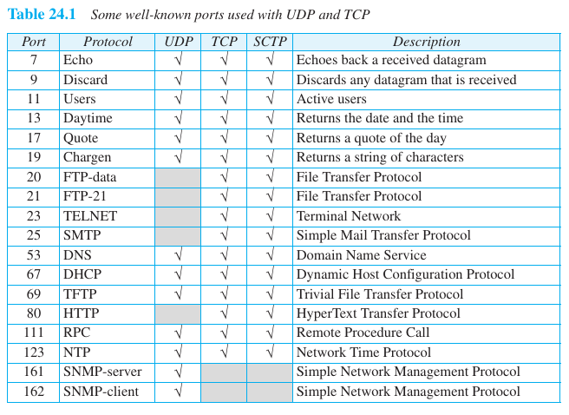
24.1.2 Port Numbers
Port numbers provide end-to-end addresses at the transport layer and allow multiplexing and demultiplexing at this layer, just as IP addresses do at the network layer. Table 24.1 gives some common port numbers for all three protocols.

Slide 97
24.2.1 User Datagram
UDP packets, called user datagrams, have a fixed-size header of 8 bytes made of four fields, each of 2 bytes (16 bits). Figure 24.2 shows the format of a user datagram.
The first two fields define the source and destination port numbers. The third field defines the total length of the user datagram, header plus data. The 16 bits can define a total length of 0 to 65,535 bytes.
However, the total length needs to be less because a UDP user datagram is stored in an IP datagram with the total length of 65,535 bytes. The last field can carry the optional checksum.

Slide 98
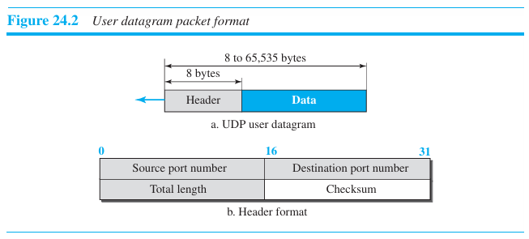

Slide 99
Example 24.1
The following is the content of a UDP header in hexadecimal format.
CB84000D001C001C
a. What is the source port number?
b. What is the destination port number?
c. What is the total length of the user datagram?
d. What is the length of the data?
e. Is the packet directed from a client to a server or vice versa?
f. What is the client process?

Slide 100
Solution
The source port number is the first four hexadecimal digits (CB84)₁₆, which means that the source port number is 52100.
The destination port number is the second four hexadecimal digits (000D)₁₆, which means that the destination port number is 13.
The third four hexadecimal digits (001C)₁₆ define the length of the whole UDP packet as 28 bytes.
The length of the data is the length of the whole packet minus the length of the header, or 28 − 8 = 20 bytes.
Since the destination port number is 13 (well-known port), the packet is from the client to the server.
The client process is the Daytime.

Slide 101
24.2.2 UDP Services
Process-to-Process Communication
UDP provides process-to-process communication using socket addresses, a combination of IP addresses and port numbers.
Connectionless Services
UDP provides a connectionless service. This means that each user datagram sent by UDP is an independent datagram. The user datagrams are not numbered.
Also, unlike TCP, there is no connection establishment and no connection termination. This means that each user datagram can travel on a different path.
Each request must be small enough to fit into one user datagram.
Only those processes sending short messages, messages less than 65,507 bytes (65,535 minus 8 bytes for the UDP header and minus 20 bytes for the IP header), can use UDP.

Slide 102
Flow Control
UDP is a very simple protocol.
There is no flow control, The receiver may overflow with incoming messages.
The process using UDP should provide this service, if needed.
Error Control
There is no error control mechanism in UDP except for the checksum.
This means that the sender does not know if a message has been lost or duplicated.
When the receiver detects an error through the checksum, the user datagram is silently discarded.
Checksum
UDP checksum calculation includes three sections: a pseudoheader, the UDP header, and the data coming from the application layer.
The pseudoheader is the part of the header of the IP packet in which the user datagram is to be encapsulated with some fields filled with 0s (see Figure 24.3).

Slide 103
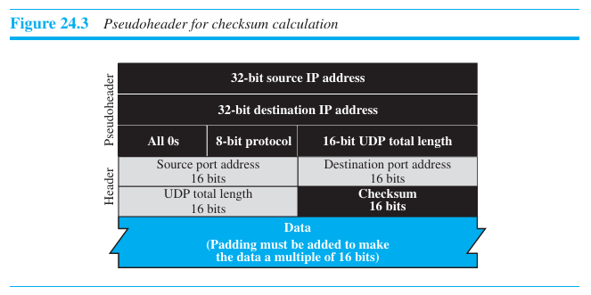

Slide 104
If the checksum does not include the pseudoheader, a user datagram may arrive safe and sound.
However, if the IP header is corrupted, it may be delivered to the wrong host.
The protocol field is added to ensure that the packet belongs to UDP, and not to TCP.
The value of the protocol field for UDP is 17.
Optional Inclusion of Checksum
The sender of a UDP packet can choose not to calculate the checksum.
In this case, the checksum field is filled with all 0s before being sent.
In the situation where the sender decides to calculate the checksum, but it happens that the result is all 0s, the checksum is changed to all 1s before the packet is sent.
This does not create confusion because the value of the checksum is never all 1s in a normal situation.

Slide 105
Example:
What value is sent for the checksum in each one of the following hypothetical situations?
The sender decides not to include the checksum.
The sender decides to include the checksum, but the value of the sum is all 1s.
The sender decides to include the checksum, but the value of the sum is all 0s.
Solution
The value sent for the checksum field is all 0s to show that the checksum is not calculated. When the sender complements the sum, the result is all 0s; the sender complements the result again before sending. The value sent for the checksum is all 1s. The second complement operation is needed to avoid confusion with the case in part a.
This situation never happens because it implies that the value of every term included in the calculation of the sum is all 0s, which is impossible; some fields in the pseudoheader have nonzero values.

Slide 106
Congestion Control
Since UDP is a connectionless protocol, it does not provide congestion control.
UDP assumes that the packets sent are small and sporadic and cannot create congestion in the network.
This assumption may or may not be true today, when UDP is used for interactive real-time transfer of audio and video.
Encapsulation and Decapsulation
To send a message from one process to another, the UDP protocol encapsulates and decapsulates messages.
Queuing
In UDP, queues are associated with ports.
At the client site, when a process starts, it requests a port number from the operating system.
Some implementations create both an incoming and an outgoing queue associated with each process.
Other implementations create only an incoming queue associated with each process.

Slide 107
Multiplexing and Demultiplexing
In a host running a TCP/IP protocol suite, there is only one UDP but possibly several processes that may want to use the services of UDP.
To handle this situation, UDP multiplexes and demultiplexes.
Comparison between UDP and Generic Simple Protocol
The only difference is that UDP provides an optional checksum to detect corrupted packets at the receiver site.
If the checksum is added to the packet, the receiving UDP can check the packet and discard the packet if it is corrupted.
No feedback, however, is sent to the sender.

Slide 108
24.2.3 UDP Applications
UDP is preferable for some applications. The reason is that some services may have some side effects that are either unacceptable or not preferable. An application designer sometimes needs to compromise to get the optimum.
UDP Features
Connectionless Service
UDP is a connectionless protocol. Each UDP packet is independent from other packets sent by the same application program.
It is an advantage if, for example, a client application needs to send a short request to a server and to receive a short response.
If the request and response can each fit in a single user datagram, a connectionless service may be preferable.
The overhead to establish and close a connection may be significant in this case.
In the connection-oriented service, to achieve the above goal, at least 9 packets are exchanged between the client and the server; in connectionless service only 2 packets are exchanged.
The connectionless service provides less delay; the connection-oriented service creates more delay. If delay is an important issue for the application, the connectionless service is preferred.

Slide 109
Example 24.3
A client-server application such as DNS uses the services of UDP because a client needs to send a short request to a server and to receive a quick response from it. Since only one message is exchanged in each direction, the client or server does not worry that messages are delivered out of order.
Example 24.4
A client-server application such as SMTP which is used in electronic mail, cannot use the services of UDP because a user might send a long e-mail message, which could include multimedia (images, audio, or video). If the application uses UDP and the message does not fit in one user datagram, the message must be split by the application into different user data grams. Here the connectionless service may create problems. The user datagrams may arrive and be delivered to the receiver application out of order. The receiver application may not be able to reorder the pieces.

Slide 110
Lack of Error Control
UDP does not provide error control; it provides an unreliable service.
Most applications expect reliable service from a transport-layer protocol.
Although a reliable service is desirable, it may have some side effects that are not acceptable to some applications.
When a transport layer provides reliable services, if a part of the message is lost or corrupted, it needs to be resent.
There is an uneven delay between different parts of the message delivered to the application layer.
Some applications, do not even notice these uneven delays, but for some they are very problematic.
Example 24.5
Assume we are downloading a very large text file from the Internet. We definitely need to use a transport layer that provides reliable service. We don’t want part of the file to be missing or corrupted when we open the file. In this case, UDP is not a suitable transport layer.

Slide 111
Example 24.6
Assume we are using a real-time interactive application, such as Skype. Audio and video are divided into frames and sent one after another. If the transport layer is supposed to resend a corrupted or lost frame, the synchronizing of the whole transmission may be lost. The viewer suddenly sees a blank screen and needs to wait until the second transmission arrives. This is not tolerable.
Lack of Congestion Control
UDP does not provide congestion control.
However, UDP does not create additional traffic in an error-prone network.
TCP may resend a packet several times and thus contribute to the creation of congestion or worsen a congested situation. Therefore, in some cases, lack of error control in UDP can be considered an advantage when congestion is a big issue.

Slide 112
Typical Applications
UDP is suitable for a process that requires simple request-response communication with little concern for flow and error control.
It is not usually used for a process such as FTP that needs to send bulk data.
UDP is suitable for a process with internal flow- and error-control mechanisms. For example, the Trivial File Transfer Protocol (TFTP) process includes flow and error control. It can easily use UDP.
UDP is a suitable transport protocol for multicasting. Multicasting capability is embedded in the UDP software but not in the TCP software.
UDP is used for management processes such as SNMP.
UDP is used for some route updating protocols such as Routing Information Proto col (RIP).
UDP is normally used for interactive real-time applications that cannot tolerate uneven delay between sections of a received message.

Slide 113
24.3 TRANSMISSION CONTROL PROTOCOL
Transmission Control Protocol (TCP) is a connection-oriented, reliable protocol.
TCP explicitly defines connection establishment, data transfer, and connection tear down phases to provide a connection-oriented service.
TCP uses a combination of GBN and SR protocols to provide reliability.
To achieve this goal, TCP uses checksum (for error detection), retransmission of lost or corrupted packets, cumulative and selective acknowledgments, and timers.
TCP is the most common transport-layer protocol in the Internet.

Slide 114
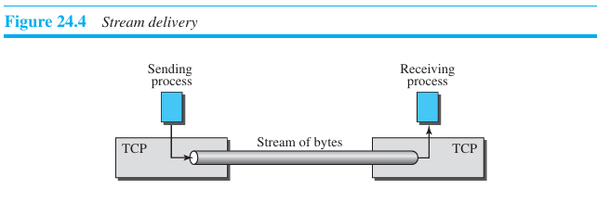
24.3.1 TCP Services
Process-to-Process Communication
As with UDP, TCP provides process-to-process communication using port numbers.
Stream Delivery Service
TCP, unlike UDP, is a stream-oriented protocol. TCP, allows the sending process to deliver data as a stream of bytes and allows the receiving process to obtain data as a stream of bytes. The sending process produces (writes to) the stream and the receiving process consumes (reads from) it as shown in Figure 24.4.

Slide 115
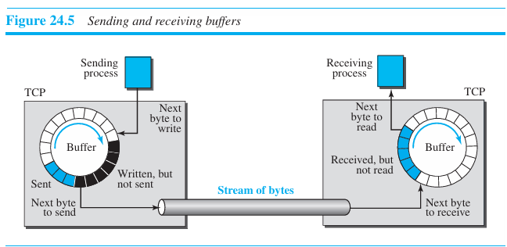
Sending and Receiving Buffers
Because the sending and the receiving processes may not necessarily write or read data at the same rate, TCP needs buffers for storage.
There are two buffers, the sending buffer and the receiving buffer, one for each direction.

Slide 116
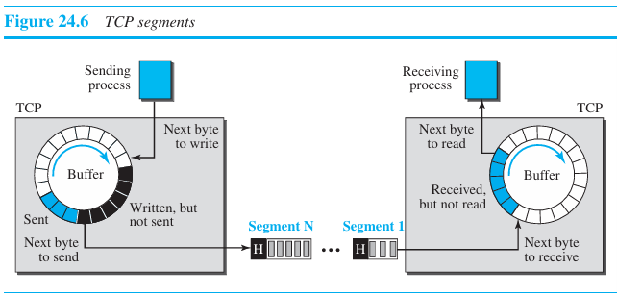
Segments
The network layer, as a service provider for TCP, needs to send data in packets, not as a stream of bytes.
At the transport layer, TCP groups a number of bytes together into a packet called a segment.
TCP adds a header to each segment (for control purposes) and delivers the segment to the network layer for transmission.
The segments are encapsulated in an IP datagram and transmitted. This entire operation is transparent to the receiving process. Figure 24.6 shows how segments are created from the bytes in the buffers.

Slide 117
Full-Duplex Communication
TCP offers full-duplex service, where data can flow in both directions at the same time.
Each TCP endpoint then has its own sending and receiving buffer, and segments move in both directions.
Multiplexing and Demultiplexing
TCP performs multiplexing at the sender and demultiplexing at the receiver.
However, since TCP is a connection-oriented protocol, a connection needs to be established for each pair of processes.

Slide 118
Connection-Oriented Service
TCP is a connection-oriented protocol. When a process at site A wants to send to and receive data from another process at site B, the following three phases occur:
The two TCP’s establish a logical connection between them.
Data are exchanged in both directions.
The connection is terminated.
Reliable Service
TCP is a reliable transport protocol. It uses an acknowledgment mechanism to check the safe and sound arrival of data.

Slide 119
24.3.2 TCP Features
Numbering System
Although the TCP software keeps track of the segments being transmitted or received, there is no field for a segment number value in the segment header.
Instead, there are two fields, called the sequence number and the acknowledgment number.
These two fields refer to a byte number and not a segment number.
Byte Number
TCP numbers all data bytes (octets) that are transmitted in a connection.
Numbering is independent in each direction.
The numbering does not necessarily start from 0. Instead, TCP chooses an arbitrary number between 0 and 2³² − 1 for the number of the first byte.

Slide 120
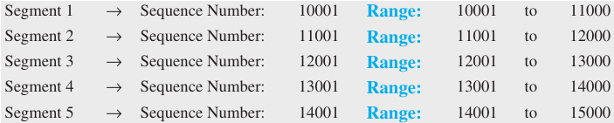
Sequence Number
After the bytes have been numbered, TCP assigns a sequence number to each segment that is being sent. The sequence number, in each direction, is defined as follows:
The sequence number of the first segment is the ISN (initial sequence number), which is a random number.
The sequence number of any other segment is the sequence number of the previous segment plus the number of bytes (real or imaginary) carried by the previous segment.
Suppose a TCP connection is transferring a file of 5000 bytes. The first byte is numbered 10001. What are the sequence numbers for each segment if data are sent in five segments, each carrying 1000 bytes?

Slide 121
Acknowledgment Number
Acknowledgment number defines the number of the next byte that the party expects to receive.
In addition, the acknowledgment number is cumulative.
The term cumulative here means that if a party uses 5643 as an acknowledgment number, it has received all bytes from the beginning up to 5642.

Slide 122
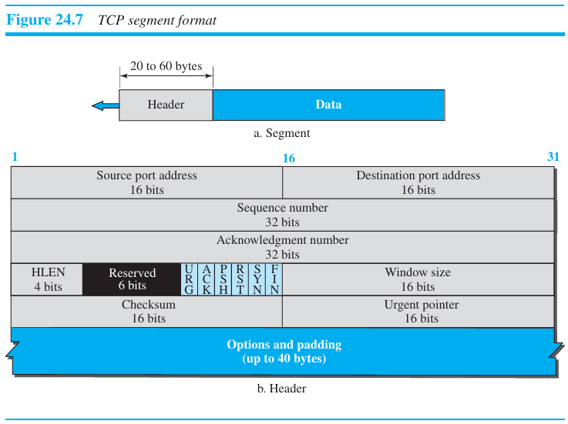
24.3.3 Segment
A packet in TCP is called a segment.
Format
The format of a segment is shown in Figure 24.7. The segment consists of a header of 20 to 60 bytes, followed by data from the application program. The header is 20 bytes if there are no options and up to 60 bytes if it contains options.

Slide 123
Source port address
This is a 16-bit field that defines the port number of the application program in the host that is sending the segment.
Destination port address
This is a 16-bit field that defines the port number of the application program in the host that is receiving the segment.
Sequence number
This 32-bit field defines the number assigned to the first byte of data contained in this segment. During connection establishment (discussed later) each party uses a random number generator to create an initial sequence number (ISN), which is usually different in each direction.
Acknowledgment number
This 32-bit field defines the byte number that the receiver of the segment is expecting to receive from the other party.

Slide 124
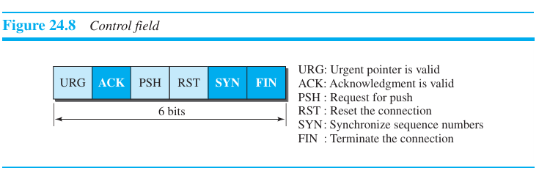
Header length
This 4-bit field indicates the number of 4-byte words in the TCP header. The length of the header can be between 20 and 60 bytes.
Control
This field defines 6 different control bits or flags, as shown in Figure 24.8.
One or more of these bits can be set at a time.
These bits enable flow control, connection establishment and termination, connection abortion, and the mode of data transfer in TCP.

Slide 125
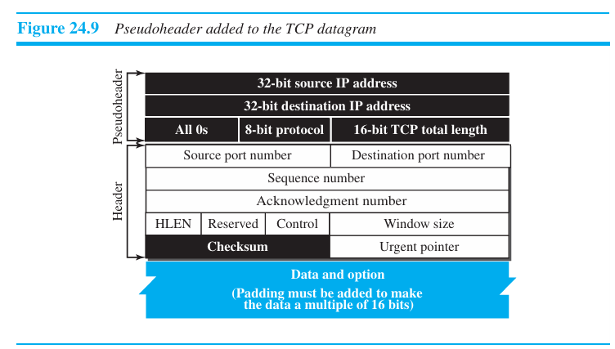
Window size
This field defines the window size of the sending TCP in bytes. This value is normally referred to as the receiving window (rwnd) and is determined by the receiver.
Checksum
This 16-bit field contains the checksum. The use of the checksum for TCP is mandatory. For the TCP pseudoheader, the value for the protocol field is 6. See Figure 24.9.

Slide 126
Urgent pointer
This field is used when the segment contains urgent data. It defines a value that must be added to the sequence number to obtain the number of the last urgent byte in the data section of the segment.
Options
There can be up to 40 bytes of optional information in the TCP header.
Encapsulation
A TCP segment encapsulates the data received from the application layer. The TCP segment is encapsulated in an IP datagram, which in turn is encapsulated in a frame at the data-link layer.

Slide 127
24.3.4 A TCP Connection
TCP is connection-oriented. A connection-oriented transport protocol establishes a logical path between the source and destination.
All of the segments belonging to a message are then sent over this logical path. TCP operates at a higher level.
TCP uses the services of IP to deliver individual segments to the receiver. If a segment is lost or corrupted, it is retransmitted.
Unlike TCP, IP is unaware of this retransmission. If a segment arrives out of order, TCP holds it until the missing segments arrive; IP is unaware of this reordering.
In TCP, connection-oriented transmission requires three phases: connection establishment, data transfer, and connection termination.

Slide 128
Connection Establishment
TCP transmits data in full-duplex mode. This implies that each party must initialize communication and get approval from the other party before any data are transferred.
Three-Way Handshaking
The connection establishment in TCP is called three-way handshaking.
For example, an application program, called the client, wants to make a connection with another application program, called the server.
The server program tells its TCP that it is ready to accept a connection.

Slide 129
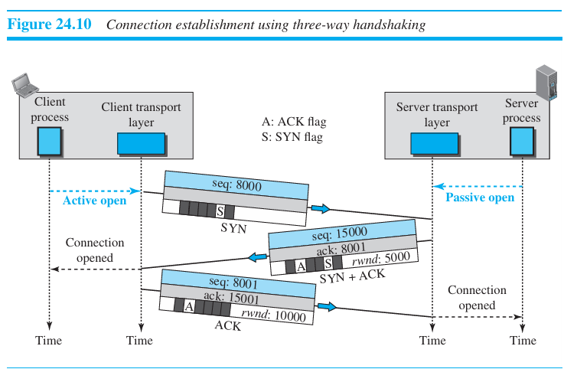

Slide 130
This request is called a passive open. Although the server TCP is ready to accept a connection from any machine in the world, it cannot make the connection itself.
The client program issues a request for an active open. A client that wishes to connect to an server tells its TCP to connect to a particular server. TCP can now start the three-way handshaking process, as shown in Figure 24.10.
The client sends the first segment, a SYN segment, in which only the SYN flag is set. This segment is for synchronization of sequence numbers. The client chooses a random number as the first sequence number and sends this number to the server. This sequence number is called the initial sequence number (ISN). Note that the SYN segment is a control segment and carries no data.
The server sends the second segment, a SYN + ACK segment with two flag bits set as: SYN and ACK. The server uses this segment to initialize a sequence number for numbering the bytes sent from the server to the client. The server also acknowledges the receipt of the SYN segment from the client by setting the ACK flag and displaying the next sequence number it expects to receive from the client.
The client sends the third segment. This is just an ACK segment. It acknowledges the receipt of the second segment with the ACK flag and acknowledgment number field. Note that the ACK segment does not consume any sequence numbers if it does not carry data.

Slide 131
SYN Flooding Attack
SYN flooding attack happens when one or more malicious attackers send a large number of SYN segments to a server pretending that each of them is coming from a different client by faking the source IP addresses.
The server, assuming that the clients are issuing an active open, allocates the necessary resources, such as creating transfer control block (TCB) tables and setting timers.
The TCP server then sends the SYN + ACK segments to the fake clients, which are lost.
When the server waits for the third segment of the handshaking process, however, resources are allocated without being used.
The server eventually runs out of resources and may be unable to accept connection requests from valid clients.
This SYN flooding attack belongs to a group of security attacks known as a denial of service attack.
Some implementations of TCP have imposed a limit of connection requests during a specified period of time. Others try to filter out datagrams coming from unwanted source addresses.
One recent strategy is to postpone resource allocation until the server can verify that the connection request is coming from a valid IP address, by using what is called a cookie.

Slide 132
Data Transfer
After connection is established, bidirectional data transfer can take place. The client and server can send data and acknowledgments in both directions.
The acknowledgment is piggybacked with the data.
Figure 24.11 shows an example. In this example, after a connection is established, the client sends 2,000 bytes of data in two segments.
The server then sends 2,000 bytes in one segment. The client sends one more segment.
The first three segments carry both data and acknowledgment, but the last segment carries only an acknowledgment because there is no more data to be sent.
Note the values of the sequence and acknowledgment numbers. The data segments sent by the client have the PSH (push) flag set so that the server TCP knows to deliver data to the server process as soon as they are received.

Slide 133
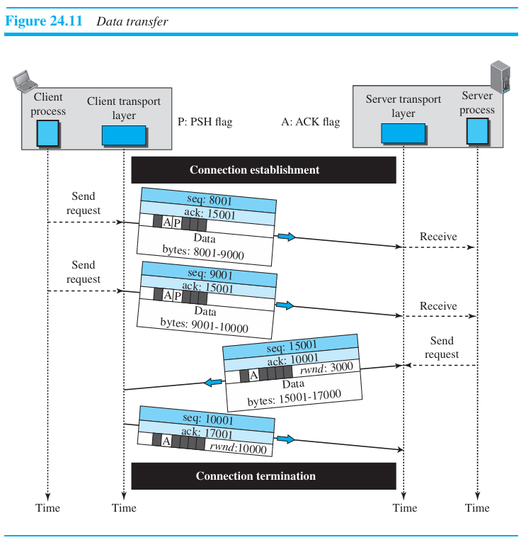

Slide 134
Pushing Data
The sending TCP uses a buffer to store the stream of data coming from the sending application program.
The sending TCP can select the segment size. The receiving TCP also buffers the data when they arrive and delivers them to the application program.
Consider an application program wants to send a chunk of data to the application program at the other site and receive an immediate response.
TCP can handle such a situation. The application program at the sender can request a push operation.
This means that the sending TCP must not wait for the window to be filled. It must create a segment and send it immediately.
The sending TCP must also set the push bit (PSH) to let the receiving TCP know that the segment includes data that must be delivered to the receiving application program as soon as possible and not to wait for more data to come.
This means to change the byte oriented TCP to a chunk-oriented TCP, but TCP can choose whether or not to use this feature.

Slide 135
Urgent Data
There are occasions in which an application program needs to send urgent bytes. The solution is to send a segment with the URG bit set. The sending application program tells the sending TCP that the piece of data is urgent.
The sending TCP creates a segment and inserts the urgent data at the beginning of the segment. The rest of the segment can contain normal data from the buffer.
The urgent pointer field in the header defines the end of the urgent data (the last byte of urgent data).
For example, if the segment sequence number is 15000 and the value of the urgent pointer is 200, the first byte of urgent data is the byte 15000 and the last byte is the byte 15200.
The receiving TCP delivers bytes (urgent or nonurgent) to the application program in order, but informs the application program about the beginning and end of urgent data.
It is left to the application program to decide what to do with the urgent data.

Slide 136
Connection Termination
Either of the two parties involved in exchanging data (client or server) can close the connection, although it is usually initiated by the client.
Two options for connection termination: three-way handshaking and four-way handshaking with a half-close option.
Three-Way Handshaking
Most implementations today allow three-way handshaking for connection termination, as shown in Figure 24.12.

Slide 137


Slide 138
The client TCP sends the first segment, a FIN segment in which the FIN flag is set. A FIN segment can include the last chunk of data sent by the client or it can be just a control segment. If it is only a control segment, it consumes only one sequence number because it needs to be acknowledged.
The server TCP, after receiving the FIN segment, informs the application and sends the second segment, a FIN + ACK segment, to confirm the receipt of the FIN segment. This segment can also contain the last chunk of data from the server. If it does not carry data, it consumes only one sequence number because it needs to be acknowledged.
The client TCP sends the last segment, an ACK segment, to confirm the receipt of the FIN segment from the TCP server. This segment contains the acknowledgment number. This segment cannot carry data and consumes no sequence numbers.

Slide 139
Half-Close
In TCP, one end can stop sending data while still receiving data. This is called a half close.
For example, when the client sends data to the server to be sorted, the client, after sending all data, can close the connection in the client-to-server direction. However, the server-to-client direction must remain open to return the sorted data. Figure 24.13 shows an example of a half-close.
The data transfer from the client to the server stops. The client half-closes the connection by sending a FIN segment. The server accepts the half-close by sending the ACK segment.
After half-closing the connection, data can travel from the server to the client and acknowledgments can travel from the client to the server. The client cannot send any more data to the server.
When the server has sent all of the processed data, it sends a FIN segment, which is acknowledged by an ACK from the client.
Connection Reset
TCP at one end may deny a connection request, may abort an existing connection, or may terminate an idle connection. All of these are done with the RST (reset) flag.

Slide 140


Slide 141
24.3.6 Windows in TCP
TCP uses two windows (send window and receive window) for each direction of data transfer,
Send Window
Figure 24.17 shows an example of a send window. The window size is 100 bytes, The figure shows how a send window opens, closes, or shrinks.
The send window in TCP is similar to the one used with the Selective-Repeat protocol, but with some differences:
One difference is the nature of entities related to the window. The window size in SR is the number of packets, but the window size in TCP is the number of bytes.
TCP can store data received from the process and send them later, but we assume that the sending TCP is capable of sending segments of data as soon as it receives them from its process.
The theoretical Selective-Repeat protocol may use several timers for each packet sent, but the TCP protocol uses only one timer.

Slide 142


Slide 143
Receive Window
Figure 24.18 shows an example of a receive window. The window size is 100 bytes. The figure also shows how the receive window opens and closes; in practice, the window should never shrink.
There are two differences between the receive window in TCP and that of SR.
The first difference is that TCP allows the receiving process to pull data at its own pace. The receive window size is always smaller than or equal to the buffer size, as shown in Figure 24.18. The receive window(rwnd) size determines the number of bytes that the receive window can accept from the sender before being overwhelmed (flow control).
rwnd = buffer size - number of waiting bytes to be pulled
The second difference is the way acknowledgments are used in the TCP protocol. Acknowledgement in SR is selective, the acknowledgment mechanism in TCP is a cumulative acknowledgment announcing the next expected byte to receive. The new version of TCP, however, uses both cumulative and selective acknowledgments.

Slide 144


Slide 145
24.3.7 Flow Control
Flow control balances the rate a producer creates data with the rate a consumer can use the data. Figure 24.19 shows unidirectional data transfer between a sender and a receiver.
The figure shows that data travel from the sending process down to the sending TCP, from the sending TCP to the receiving TCP, and from the receiving TCP up to the receiving process (paths 1, 2, and 3).
Flow control feedbacks, however, are traveling from the receiving TCP to the sending TCP and from the sending TCP up to the sending process (paths 4 and 5).
Flow control feedback from the sending TCP to the sending process (path 5) is achieved through simple rejection of data by the sending TCP when its window is full.

Slide 146


Slide 147
Opening and Closing Windows
To achieve flow control, TCP forces the sender and the receiver to adjust their window sizes, although the size of the buffer for both parties is fixed when the connection is established.
The receive window closes (moves its left wall to the right) when more bytes arrive from the sender; it opens (moves its right wall to the right) when more bytes are pulled by the process.
The send window closes (moves its left wall to the right) when a new acknowledgment allows it to do so.
The send window opens (its right wall moves to the right) when the receive window size (rwnd) advertised by the receiver allows it to do so (new ackNo + new rwnd > last ackNo + last rwnd). The send window shrinks in the event this situation does not occur.

Slide 148

A Scenario
How the send and receive windows are set during the connection establishment phase, and how their situations will change during data transfer is shown

Slide 149
Eight segments are exchanged between the client and server:
The first segment is from the client to the server (a SYN segment) to request connection. The client announces its initial seqNo = 100. When this segment arrives at the server, it allocates a buffer size of 800 (an assumption) and sets its window to cover the whole buffer (rwnd = 800).
The second segment is from the server to the client. This is an ACK + SYN segment. The segment uses ackNo = 101. It also announces that the client can set a buffer size of 800 bytes.
The third segment is the ACK segment from the client to the server. Note that the client has defined a rwnd of size 2000, but we do not use this value in our figure because the communication is only in one direction.
After the client has set its window with the size (800) dictated by the server, the process pushes 200 bytes of data. The TCP client numbers these bytes 101 to 300. It then creates a segment and sends it to the server. The window of the client is then adjusted to show that 200 bytes of data are sent but waiting for acknowledgment. When this segment is received at the server, the bytes are stored, and the receive window closes to show that the next byte expected is byte 301.

Slide 150
The fifth segment is the feedback from the server to the client. The server acknowledges bytes up to and including 300 (expecting to receive byte 301). The segment also carries the size of the receive window after decrease (600). The client, after receiving this segment, purges the acknowledged bytes from its window and closes its window to show that the next byte to send is byte 301. The window size, however, decreases to 600 bytes. Although the allocated buffer can store 800 bytes, the window cannot open (moving its right wall to the right) because the receiver does not let it.
Segment 6 is sent by the client after its process pushes 300 more bytes. The segment defines seqNo as 301 and contains 300 bytes. When this segment arrives at the server, the server stores them, but it has to reduce its window size. After its process has pulled 100 bytes of data, opens from the right for the amount of 100 bytes.
In segment 7, the server acknowledges the receipt of data, and announces that its window size is 400. When this segment arrives at the client, the client has no choice but to reduce its window again and set the window size to the value of rwnd = 400 advertised by the server.
Segment 8 is also from the server after its process has pulled another 200 bytes. Its window size increases. The new rwnd value is now 600. The segment informs the client that the server still expects byte 601, but the server window size has expanded to 600. Some implementations may not allow advertisement of the rwnd at this time; the server then needs to receive some data before doing so.

Slide 151
Shrinking of Windows
The receive window cannot shrink. The send window, on the other hand, can shrink if the receiver defines a value for rwnd that results in shrinking the window.
In other words, the receiver needs to keep the following relationship between the last and new acknowledgment and the last and new rwnd values to prevent shrinking of the send window.
new ackNo + new rwnd ≥ last ackNo + last rwnd
The left side of the inequality represents the new position of the right wall with respect to the sequence number space; the right side shows the old position of the right wall.
The relationship shows that the right wall should not move to the left. The inequality is a mandate for the receiver to check its advertisement.
However, the inequality is valid only if S_{f} < S_{n}; we need to remember that all calculations are in modulo 2³².

Slide 152


Slide 153
Window Shutdown
Shrinking the send window by moving its right wall to the left is strongly discouraged.
However, there is one exception: the receiver can temporarily shut down the window by sending a rwnd of 0.
This can happen if for some reason the receiver does not want to receive any data from the sender for a while. In this case, the sender does not actually shrink the size of the window, but stops sending data until a new advertisement has arrived.
Even when the window is shut down by an order from the receiver, the sender can always send a segment with 1 byte of data. This is called probing and is used to prevent a deadlock.

Slide 154
Silly Window Syndrome
A serious problem can arise in the sliding window operation when either the sending application program creates data slowly or the receiving application program consumes data slowly, or both. This problem is called the silly window syndrome.
Syndrome Created by the Sender
The sending TCP may create a silly window syndrome if it is serving an application program that creates data slowly, for example, 1 byte at a time, the sending TCP may create segments containing 1 byte of data.
The result is a lot of 41-byte segments that are traveling through an internet.
The solution is the sending TCP must be forced to wait and collect data to send in a larger block. How long should the sending TCP wait?
Nagle found an elegant solution. Nagle’s algorithm is simple:
The sending TCP sends the first piece of data it receives from the sending application program even if it is only 1 byte.
After sending the first segment, the sending TCP accumulates data in the output buffer and waits until either the receiving TCP sends an acknowledgment or until enough data have accumulated to fill a maximum-size segment. At this time, the sending TCP can send the segment.
Step 2 is repeated for the rest of the transmission.

Slide 155
Syndrome Created by the Receiver
The receiving TCP may create a silly window syndrome if it is serving an application program that consumes data slowly, for example, 1 byte at a time.
Two solutions have been proposed to prevent the silly window syndrome Clark’s solution is to send an acknowledgment as soon as the data arrive, but to announce a window size of zero until either there is enough space to accommodate a segment of maximum size or until at least half of the receive buffer is empty.
The second solution is to delay sending the acknowledgment. This means that when a segment arrives, it is not acknowledged immediately. The receiver waits until there is a decent amount of space in its incoming buffer before acknowledging the arrived segments. The delayed acknowledgment prevents the sending TCP from sliding its window. This kills the syndrome.
Delayed acknowledgment also has another advantage: it reduces traffic. The receiver does not have to acknowledge each segment. However, there also is a disadvantage in that the delayed acknowledgment may result in the sender unnecessarily retransmitting the unacknowledged segments.

Slide 156
24.3.8 Error Control
TCP provides reliability using error control.
Error control includes mechanisms for detecting and resending corrupted segments, resending lost segments, storing out-of order segments until missing segments arrive, and detecting and discarding duplicated segments.
Error control in TCP is achieved through the use of three simple tools: checksum, acknowledgment, and time-out.
Checksum
Each segment includes a checksum field, which is used to check for a corrupted segment.
If a segment is corrupted, as detected by an invalid checksum, the segment is discarded by the destination TCP and is considered as lost.
TCP uses a 16-bit checksum that is mandatory in every segment.

Slide 157
Acknowledgment
TCP uses acknowledgments to confirm the receipt of data segments. Control segments that carry no data, but consume a sequence number, are also acknowledged. ACK segments are never acknowledged.
TCP implementations provide cumulative acknowledgment as well as selective acknowledgment.
Cumulative Acknowledgment (ACK)
TCP was originally designed to acknowledge receipt of segments cumulatively.
The receiver advertises the next byte it expects to receive, ignoring all segments received and stored out of order. No feedback is provided for discarded, lost, or duplicate segments.
The 32-bit ACK field in the TCP header is used for cumulative acknowledgments, and its value is valid only when the ACK flag bit is set to 1.

Slide 158
Selective Acknowledgment (SACK)
A SACK does not replace an ACK, but reports additional information to the sender.
A SACK reports a block of bytes that is out of order, and also a block of bytes that is duplicated.
However, since there is no provision in the TCP header for adding this type of information, SACK is implemented as an option at the end of the TCP header.

Slide 159
Generating Acknowledgments
When does a receiver generate acknowledgments? The most common rules are:
When end A sends a data segment to end B, it must include (piggyback) an acknowledgment that gives the next sequence number it expects to receive.
When the receiver has no data to send and it receives an in-order segment (with expected sequence number), the receiver delays sending an ACK segment until another segment arrives or until a period of time (normally 500 ms) has passed. This rule reduces ACK segments.
When a segment arrives with a sequence number that is expected by the receiver, and the previous in-order segment has not been acknowledged, the receiver immediately sends an ACK segment.
When a segment arrives with an out-of-order sequence number that is higher than expected, the receiver immediately sends an ACK segment announcing the sequence number of the next expected segment. This leads to the fast retransmission of missing segments.
When a missing segment arrives, the receiver sends an ACK segment to announce the next sequence number expected. This informs the receiver that segments reported missing have been received.
If a duplicate segment arrives, the receiver discards the segment, but immediately sends an acknowledgment indicating the next in-order segment expected. This solves some problems when an ACK segment itself is lost.

Slide 160
Retransmission
When a segment is sent, it is stored in a queue until it is acknowledged.
When the retransmission timer expires or when the sender receives three duplicate ACKs for the first segment in the queue, that segment is retransmitted.
Retransmission after RTO
The sending TCP maintains one retransmission time-out (RTO) for each connection.
When the timer matures, i.e. times out, TCP resends the segment in the front of the queue and restarts the timer. We assume S_{f} < S_{n}.
The value of RTO is dynamic in TCP and is updated based on the round-trip time (RTT) of segments. RTT is the time needed for a segment to reach a destination and for an acknowledgment to be received.

Slide 161
Retransmission after Three Duplicate ACK Segments
Allowing senders to retransmit without waiting for a time out, most implementations follow the three duplicate ACKs rule and retransmit the missing segment immediately.
This feature is called fast retransmission. In this version, if three duplicate acknowledgments (i.e., an original ACK plus three exactly identical copies) arrive for a segment, the next segment is retransmitted without waiting for the time-out.
Out-of-Order Segments
TCP implementations today do not discard out-of-order segments. They store them temporarily and flag them as out-of-order segments until the missing segments arrive.
However, out-of-order segments are not delivered to the process immediately. TCP guarantees that data are delivered to the process in order.

Slide 162
FSMs for Data Transfer in TCP
Since TCP accepts out-of-order segments, TCP can be thought of as behaving more like the SR protocol, but since the original acknowledgments are cumulative, it looks like GBN.
However, if the TCP implementation uses SACKs, then TCP is closest to SR.
Sender-Side FSM
Figure 24.22 shows the simplified FSM for the sender site.
The FSM is rudimentary; it does not include issues such as silly window syndrome or window shutdown.
It defines a unidirectional communication, ignoring all issues that affect bidirectional communication.

Slide 163


Slide 164
Receiver-Side FSM
Assume that the communication is unidirectional and the segments are acknowledged using ACK segments. Also ignore the selective acknowledgment and congestion control.
Figure 24.23 shows the simplified FSM for the receiver. Some issues such as silly window syndrome (Clark’s solution) and window shutdown are ignored.

Slide 165


Slide 166
Some Scenarios
Normal Operation
The first scenario shows bidirectional data transfer between two systems as shown in Figure 24.24. The client TCP sends one segment; the server TCP sends three.
When the client receives the first segment from the server, it does not have any more data to send; it needs to send only an ACK segment.
However, the acknowledgment needs to be delayed for 500 ms to see if any more segments arrive. When the ACK-delaying timer matures, it triggers an acknowledgment.
However, before timer matures, the third segment arrives. The arrival of the third segment triggers another acknowledgment.

Slide 167


Slide 168

Lost Segment
A lost or corrupted segment is treated the same way by the receiver. Both are considered lost. Figure 24.25 shows a situation in which a segment is lost.

Slide 169
The sender sends segments 1 and 2, which are acknowledged immediately by an ACK (rule 3).
Segment 3, however, is lost. The receiver receives segment 4, which is out of order.
The receiver immediately sends an acknowledgment to the sender displaying the next byte it expects.
Note that the receiver stores bytes 801 to 900, but never delivers these bytes to the application until the gap is filled.

Slide 170
Fast Retransmission
The sender receives four acknowledgments with the same value (three duplicates).
Although the timer has not matured, the rule for fast retransmission requires that segment 3, the segment that is expected by all of these duplicate acknowledgments, be resent immediately.
After resending this segment, the timer is restarted.

Slide 171


Slide 172
Delayed Segment
Delayed segments sometimes may time out and be resent.
If the delayed segment arrives after it has been resent, it is considered a duplicate segment and discarded.
Duplicate Segment
When a segment arrives that contains a sequence number equal to an already received and stored segment, it is discarded. An ACK is sent with ackNo defining the expected segment.
Automatically Corrected Lost ACK
In the TCP acknowledgment mechanism, a lost acknowledgment may not even be noticed by the source TCP.
TCP uses cumulative acknowledgment.
We can say that the next acknowledgment automatically corrects the loss of the previous acknowledgment shown in Figure 24.27.

Slide 173


Slide 174


Slide 175
When the receiver receives a duplicate segment, it discards it and resends the last ACK immediately to inform the sender that the segment or segments have been received.
When the sender receives the retransmitted ACK, it knows that both segments were received because the acknowledgment is cumulative.

Slide 176
Deadlock Created by Lost Acknowledgment
There is one situation in which loss of an acknowledgment may result in system dead lock.
This is the case in which a receiver sends an acknowledgment with rwnd set to 0 and requests that the sender shut down its window temporarily.
After a while, the receiver wants to remove the restriction; however, if it has no data to send, it sends an ACK segment and removes the restriction with a nonzero value for rwnd.
A problem arises if this acknowledgment is lost. The sender is waiting for an acknowledgment that announces the nonzero rwnd.
The receiver thinks that the sender has received this and is waiting for data. This situation is called a deadlock; A retransmission timer is not set.

Slide 177
24.3.9 TCP Congestion Control
TCP uses different policies to handle the congestion in the network.
Congestion Window
TCP is an end-to-end protocol that uses the service of IP. IP is a simple protocol with no congestion control. TCP, itself, needs to be responsible for this problem.
TCP needs to define policies that accelerate the data transmission when there is no congestion and decelerate the transmission when congestion is detected in the network.
To control the number of segments to transmit, TCP uses the congestion window, cwnd, whose size is controlled by the congestion in the network.
The cwnd variable and the rwnd variable together define the size of the send window in TCP.
The first is related to the congestion in the middle (network); the second is related to the congestion at the end. The actual size of the window is the minimum of these two.
Actual window size = minimum (rwnd, cwnd)

Slide 178
Congestion Detection
The TCP sender uses the occurrence of two events as signs of congestion in the network: time-out and receiving three duplicate ACKs.
If a TCP sender does not receive an ACK for a segment or a group of segments before the time-out occurs, it assumes that the corresponding segment or segments are lost and the loss is due to congestion.
Congestion in the case of three duplicate ACKs can be less severe than in the case of time-out.
When a receiver sends three duplicate ACKs, it means that one segment is missing, but three segments have been received. The network is either slightly congested or has recovered from the congestion.

Slide 179
Congestion Policies
TCP’s general policy for handling congestion is based on three algorithms: slow start, congestion avoidance, and fast recovery.
Slow Start: Exponential Increase
The slow-start algorithm is based on the idea that the size of the congestion window (cwnd) starts with one maximum segment size (MSS), but it increases one MSS each time an acknowledgment arrives.
The sender starts with cwnd = 1 (Figure 24.29). This means that the sender can send only one segment.
After the first ACK arrives, the size of the congestion window is also increased by 1 because the arrival of the acknowledgment indicates there is no congestion in the network.
The size of the window is now 2. After sending two segments and receiving two individual acknowledgments for them, the size of the congestion window now becomes 4, and so on.
If an ACK arrives, cwnd = cwnd + 1

Slide 180


Slide 181

If we look at the size of the cwnd in terms of round-trip times (RTTs), we find that the growth rate is exponential in terms of each round trip time, which is a very aggressive approach:
When the size of the window in bytes reaches the threshold, ssthresh (slow-start threshold), slow start stops and the next phase starts.

Slide 182
Congestion Avoidance: Additive Increase
When the size of the window in bytes reaches the threshold, ssthresh (slow-start threshold), slow start stops and the congestion avoidance phase starts.
Which increases the cwnd additively instead of exponentially. In this algorithm, each time the whole “window” of segments is acknowledged, the size of the congestion window is increased by one. A window is the number of segments transmitted during RTT.
If an ACK arrives, cwnd = cwnd + (1/cwnd)
Figure 24.30 shows the idea.

Slide 183


Slide 184

The size of the window increases only 1/cwnd portion of MSS (in bytes).
In other words, all segments in the previous window should be acknowledged to increase the window by 1 MSS bytes.
If we look at the size of the cwnd in terms of round-trip times (RTTs), we find that the growth rate is linear in terms of each round-trip time, which is much more conservative than the slow-start approach.

Slide 185
Fast Recovery
The fast-recovery algorithm is optional in TCP. It starts when three duplicate ACKs arrive, which is interpreted as light congestion in the network. Like congestion avoidance, this algorithm is also an additive increase, but it increases the size of the congestion window when a duplicate ACK arrives. We can say,
If a duplicate ACK arrives, cwnd = cwnd + (1 / cwnd)
Policy Transition
The three versions of TCP are Taho TCP, Reno TCP, and New Reno TCP.
Taho TCP
The early TCP, known as Taho TCP, used only two different algorithms in their congestion policy: slow start and congestion avoidance.

Slide 186


Slide 187
Figure 24.31 shows the simplified FSM for this version of TCP.
In this version, when the connection is established, TCP starts the slow-start algorithm and sets the ssthresh variable to a pre-agreed value and the cwnd to 1 MSS.
In this state, each time an ACK arrives, the size of the congestion window is incremented by 1.
If congestion is detected, TCP immediately interrupts this aggressive growth and restarts a new slow start algorithm by limiting the threshold to half of the current cwnd and resetting the congestion window to 1.
If no congestion is detected while reaching the threshold, it moves to the congestion avoidance state and continues in that state.
In the congestion-avoidance state, the size of the congestion window is increased by 1 each time a number of ACKs equal to the current size of the window has been received.
The conservative additive growth of the congestion window continues to the end of the data transfer phase unless congestion is detected.
If congestion is detected in this state, TCP again resets the value of the ssthresh to half of the current cwnd and moves to the slow-start state again.

Slide 188

Example 24.9
Figure 24.32 shows an example of congestion control in a Taho TCP.

Slide 189
Reno TCP
Reno TCP, added a new state to the congestion-control FSM, called the fast-recovery state.
This version treated the two signals of congestion, time-out and the arrival of three duplicate ACKs, differently.
In this version, if a time-out occurs, TCP moves to the slow-start state, on the other hand, if three duplicate ACKs arrive, TCP moves to the fast-recovery state and remains there as long as more duplicate ACKs arrive.
The fast-recovery state behaves like the slow start, in which the cwnd grows exponentially, but the cwnd starts with the value of ssthresh plus 3 MSS (instead of 1).

Slide 190


Slide 191
When TCP enters the fast-recovery state, three major events may occur. If duplicate ACKs continue to arrive, TCP stays in this state, but the cwnd grows exponentially.
If a time-out occurs, TCP assumes that there is real congestion in the network and moves to the slow-start state.
If a new (non duplicate) ACK arrives, TCP moves to the congestion-avoidance state, but deflates the size of the cwnd to the ssthresh value, as though the three duplicate ACKs have not occurred.
Figure 24.33 shows the simplified FSM for Reno TCP.

Slide 192

Example 24.10
Figure 24.34 shows the example of congestion control in a Taho TCP.

Slide 193
NewReno TCP
A later version of TCP, called NewReno TCP, made an extra optimization on the Reno TCP.
In this version, TCP checks to see if more than one segment is lost in the current window when three duplicate ACKs arrive.
When TCP receives three duplicate ACKs, it retransmits the lost segment until a new ACK (not duplicate) arrives.
If the new ACK defines the end of the window when the congestion was detected, TCP is certain that only one segment was lost.
However, if the ACK number defines a position between the retransmitted segment and the end of the window, it is possible that the segment defined by the ACK is also lost. NewReno TCP retransmits this segment to avoid receiving more and more duplicate ACKs for it.

Slide 194
Additive Increase, Multiplicative Decrease
In a long TCP connection, if we ignore the slow-start states and short exponential growth during fast recovery, the TCP congestion window is cwnd = cwnd + (1 / cwnd) when an ACK arrives (congestion avoidance), and cwnd = cwnd / 2 when congestion is detected, as though SS does not exist and the length of FR is reduced to zero.
The first is called additive increase; the second is called multiplicative decrease.
This means that the congestion window size, after it passes the initial slow-start state, follows a saw tooth pattern called additive increase, multiplicative decrease (AIMD), as shown in Figure 24.35.

Slide 195


Slide 196
TCP Throughput
The behavior of TCP, as shown in Figure 24.35, is like saw teeth, with many minimum and maximum values.
If each tooth were exactly the same, we could say that the throughput = [(maximum + minimum) / 2] / RTT.
However, we know that the value of the maximum is twice the value of the minimum because in each congestion detection the value of cwnd is set to half of its previous value. So the throughput can be better calculated as
throughput = (0.75) Wmax / RTT
in which Wmax is the average of window sizes when the congestion occurs.

Slide 197

Example 24.11
If MSS = 10 KB (kilobytes) and RTT = 100 ms in Figure 24.35, we can calculate the throughput as shown below.

